Slide 1
ONLINE
2015
A BRAND NEW WORLD….BEST PRACTICES

Slide 2
TRANSITIONING TO eTests Online There is nothing to it…but to do it…

Slide 3
BEFORE, DURING and AFTER…
Preparation
Timetable
Technology
Training
Communication
COLLABORATION

Slide 4
Preparation
District support
Plan
-Schools, labs, test security, computers, users,
training
Organize assignments and meetings
Create a calendar
Adjust and revise
Monitor

Slide 5
TIMETABLE
Detailed
Date
Time
Task/Assignment
Owners
Telephone numbers and emails

Slide 6
TECHNOLOGY
Computer needs and requirements
- Silverlight
Designate one point of contact
Registration of computers (one point of contact)
Export of test data (one year)

Slide 7
SCHOOL’S RESPONSIBILITY
Identify computer lab(s) for the pilot.
Provide names of all coordinators, proctors and test administrators.
Technicians install necessary software.
Testing staff needs to complete all certification requirements before going “live”.
Make sure students go through the oral intake screening process.
Ensure students are pre and post-tested with eTests Online.
Monitor Web Test Units (WTUs)
Print daily Student Summary Report to verify with testing log.

Slide 8
TRAINING
Manual
Train all users
CASAS Security Requirements
- Agency Security Agreement (Director)
- CASAS Proctor Online Training
- CASAS Coordinator Online Training
TOPSpro Enterprise (TE) Training
Webinars

Slide 9
Required Training
Coordinator Certification
Proctor Certification
CASAS IT (Implementation Training)
eTests Training

Slide 10
ONLINE DATABASES
Tutorial Database – to complete TOPSpro Enterprise Online self-training exercises (Rolling Hills fictitious data)
Production Database – live, to conduct actual tests

Slide 11
CASAS ONLINE TRAINING
Go to www.casas.org
Create CASAS Profile
Online Training
Complete Online Coordinator/Proctor Modules for CASAS eTests

Slide 12
PILOT PHASE
Start with One School
Identify how many schools will be converting.
Review enrollment, testing staff available, computers, etc.
Then select one school for pilot phase.
- One term
- All new students and returning
- Converting from eTests to eTests Online
- Identify challenges

Slide 13
PHASE 1
Identify how many schools will be converting at one time. Review enrollment, testing staff available, computers, etc. Then select schools.
Best Practice -- Conversion of 1-3 schools (including off sites)

Slide 14
PHASE 2
Add additional number of schools
Best Practice -- Conversion of no more than 4-5 additional school sites at a time (including off site locations)

Slide 15
PHASE 3
Conversion of all remaining schools
Best Practice: Conversion of remaining schools (including off-sites)

Slide 16
BACK-UP TESTING OPTIONS
eTests
If transitioning from eTests Desktop to eTests
Online maintain the Dongles as a backup until full
conversion is completed.
Pencil and Paper
Keep minimum current inventory

Slide 17
TOPSpro Enterprise (TE)
Individual Skills Profile
Student Competency Performance
Personal Score Report (PSR) -- Shows test results summary and scale score descriptor of an individual test-taker on a given test form. Option to display on-screen at the end of a test with option to print.
Student Test Summary
Class Performance Reports
Students With No Tests
Next-Assigned Test (NAT)
eTests Online Administrations (WTUs)

Slide 18
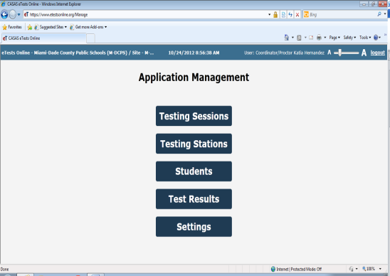
ONLINE LOGIN PAGE
Testing Sessions
Displays the list of sessions created
Testing Stations
Displays the list of testing stations
Students
Test Results
Displays the list of test results
Settings
Displays settings

Slide 19
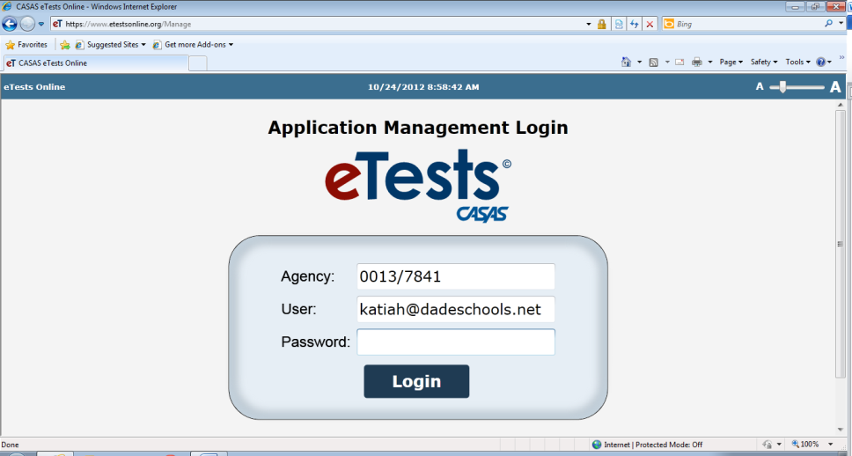

Slide 20
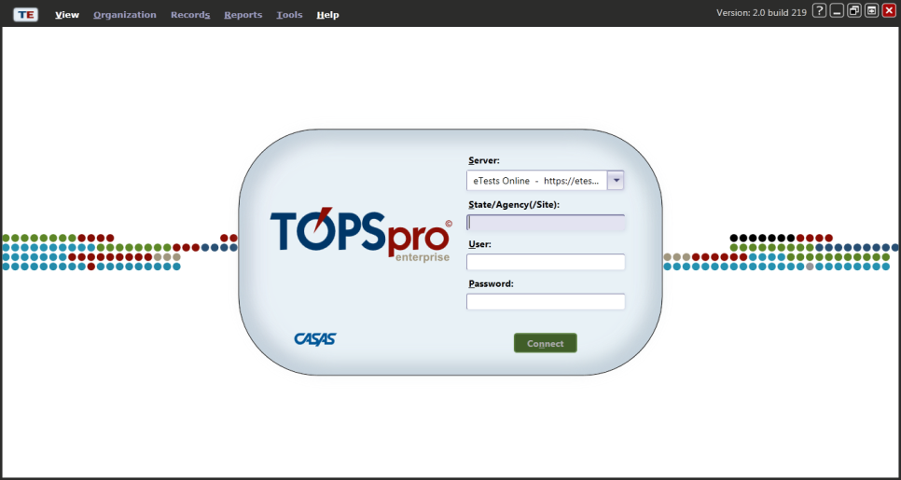
TOPSpro ENTERPRISE (TE)
Please remember to have TE open simultaneously with CASAS etests Online.

Slide 21
Station Configuration
Designate only a few people , preferably a technician to complete the station configurations.
Test Irregularities Report (TIR)
Have a systematic process to report irregularities and test interruptions.
TOPSpro Enterprise (TE)
Recommended every school to have a TE Administrator with access to all features

Slide 22
CREATING TESTING SESSIONS
All testing sessions the same with same configuration settings
Post-test
Pre-Test 6+ (Locator)
Retest Same Day
Practice Sessions

Slide 23
STUDENT TESTING SCREEN
Students need to review new format available as a Power Point Presentation in www. casas.org

Slide 24
Contact
FL State and National Certified CASAS Trainer
Veronica Pavon Baker
305.531.0451, Ext 2407
CASAS Office -- 800-255-1036
Tech Support from 9 am to 8 pm Eastern time: press 2
To get started with eTests: Carol Farrell, ext. 123
eTests Training: Dawn Montgomery, ext. 126

