Slide 1


INSTITUTE FOR THE PROFESSIONAL
DEVELOPMENT OF ADULT EDUCATORS
An Introduction to the ABE Mathematics Curriculum Matrix
Concept and Applications
www.floridaipdae.org
This training event is supported with federal funds as appropriated to the Florida Department of Education, Division of Career and Adult Education for the provision of state leadership professional development activities.

Slide 2

Agenda
BY EDUCATORS FOR EDUCATORS
The Purpose of the Matrix
The College and Career Readiness Standards
The ABE Mathematics Curriculum Frameworks
The ABE Mathematics Curriculum Matrix
The Purpose of the Matrix
Matrix Alignment to TABE 11 & 12
Various Matrix Overlays
The Interactive Online Curriculum Matrix
Additional Curriculum Matrix Resources
Notes:
2
Go over the presentation agenda.

Slide 3


The Purpose of the Matrix
Rationale
3
2017-18 The Institute for the Professional Development of Adult Educators
Notes:
Use this as a transition slide for presenting the reasoning behind the development of the ABE Math Curriculum Matrix.

Slide 4
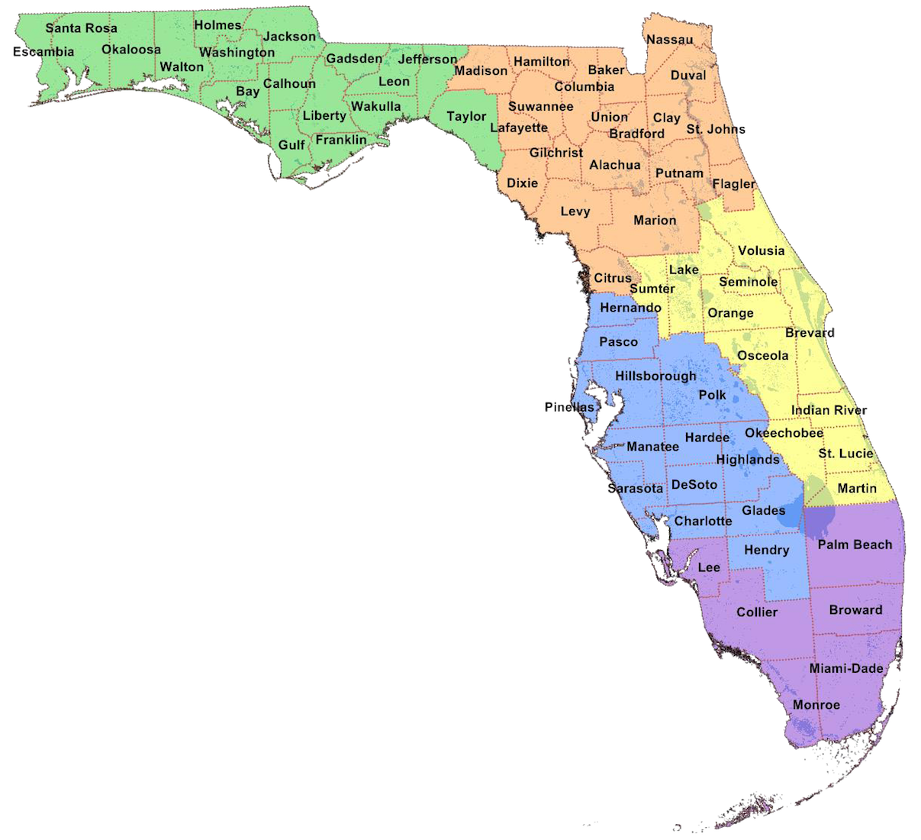
Challenges of Educators
Workbook p. 1
Adult Educators across the state are facing very similar challenges in the teaching of ABE Mathematics:
Inconsistent background in math
Unfamiliarity to certain math skills and concepts
Limited understanding of the standards (CCRS)
Lack of planning time
Limited access to professional development
Limited knowledge of math teaching strategies
Limited resources for properly teaching math skills
Massive and often multiple math content/curricula
Catering to a very diverse group of students in terms of ability, background and goals
4
2017-18 The Institute for the Professional Development of Adult Educators
Notes:
Go over the common challenges adult educators face in teaching ABE Mathematics.
Inconsistent background in math – several teachers do not have a solid mathematics education backgrou
Unfamiliarity to certain math skills and concepts – several teachers who do not have mathematics background are unfamiliar with certain math skills and concepts
Limited understanding of the standards (CCRS) – teachers may or may not be thoroughly trained in CCRS
Lack of planning time
Limited access to professional development
Limited knowledge of math teaching strategies – there are certain strategies for teaching specific math content that leads into better understanding and retention
Limited resources for properly teaching math skills – including online resources
Massive and often multiple math content/curricula
Catering to a very diverse group of students in terms of ability, background and goals – adult students are diverse in ability, backgrounds (cultural, socio-economic, and formal education) and goals (GED, college, career, lifelong learning, etc.)

Slide 5
Reflections of an Educator
Workbook p. 1
In terms of teaching math, a typical adult educator struggles with the following questions:
Where do I start?
Which skills and concepts do my students need more mastery? How do I know now? How will I know in the future?
How much time do I have to teach this topic?
What topics should I teach next? What is the end goal?
Is this skill assessed on standardized tests? How?
How much of this content is assessed on standardized tests?
What is the best textbook out there? Or websites to use?
5
2017-18 The Institute for the Professional Development of Adult Educators
Notes:
Go over the common questions of adult educators in the teaching of ABE Mathematics.

Slide 6
The ABE Mathematics Curriculum Matrix helps adult educators deal with the challenges of their work and answer the most important questions to be more efficient in their practice.
6
2017-18 The Institute for the Professional Development of Adult Educators
Notes:
Ask one of the participants to read this slide while the rest reads silently.

Slide 7

The College and Career Readiness Standards
The Teaching of Mathematics According to:
7
2017-18 The Institute for the Professional Development of Adult Educators
Notes:
In order to understand how the matrix works, adult educators need to understand the College and Career Readiness Standards.

Slide 8
CCRS
BY EDUCATORS FOR EDUCATORS
The Key Shifts in the Standards
      Focus
      Coherence
      Rigor
        Conceptual Understanding
        Procedural Fluency
        Application
Notes:
The College and Career Readiness Standards (CCRS) explains the following shifts in the standards. The next few slides will go over the implications of each shift with classroom instruction.

Slide 9
CCRS
BY EDUCATORS FOR EDUCATORS
Focus
      Focusing strongly where the standards focus
Instructors need to:
narrow significantly and to deepen the manner in which they teach mathematics
focus deeply on the major work of each level
select priority content which addresses clear understanding
Notes:
Key Points:
Teachers need to narrow down mathematics content to what is important to college and career.
Less content will allow teachers to focus more on each skill that would allow for greater mastery.
Less content will allow teachers to design lessons that allows for clearer understanding on the part of the students.

Slide 10
CCRS
BY EDUCATORS FOR EDUCATORS
Coherence
      Designing learning around coherent progressions level to level
Instructors need to:
create coherent progressions in the content within and across levels
establish strong conceptual understanding of core content
use standards at higher levels as extensions of previous learning rather than signaling a new concept or idea
Notes:
Key Points:
Teachers need to show the relationships between mathematics content and skills to allow greater retention on the part of students.
Teachers need to sequence topics to show how mathematics topics build upon each other.

Slide 11
CCRS
BY EDUCATORS FOR EDUCATORS
Rigor
      Pursuing conceptual understanding, procedural skill and fluency, and application—all with equal intensity
Instructors need to:
focus equally on conceptual understanding of key concepts, procedural skill and fluency, and rigorous application of mathematics in real-world contexts.
teach more than “how to get the answer”
employ concepts from several perspectives
Notes:
Key Points:
Teachers need to spent proportionate amounts of time for conceptual understanding, procedural skill and rigorous application of mathematics.
In addition to “how,” teachers need to explain the “why” behind each mathematical concept or skill.

Slide 12
The Curriculum Frameworks
The Starting Point of the ABE Math Curriculum Matrix
12
2017-18 The Institute for the Professional Development of Adult Educators
Notes:
Transition slide for presenting the relationship between the ABE Mathematics Curriculum Frameworks and the ABE Mathematics Curriculum Matrix.

Slide 13
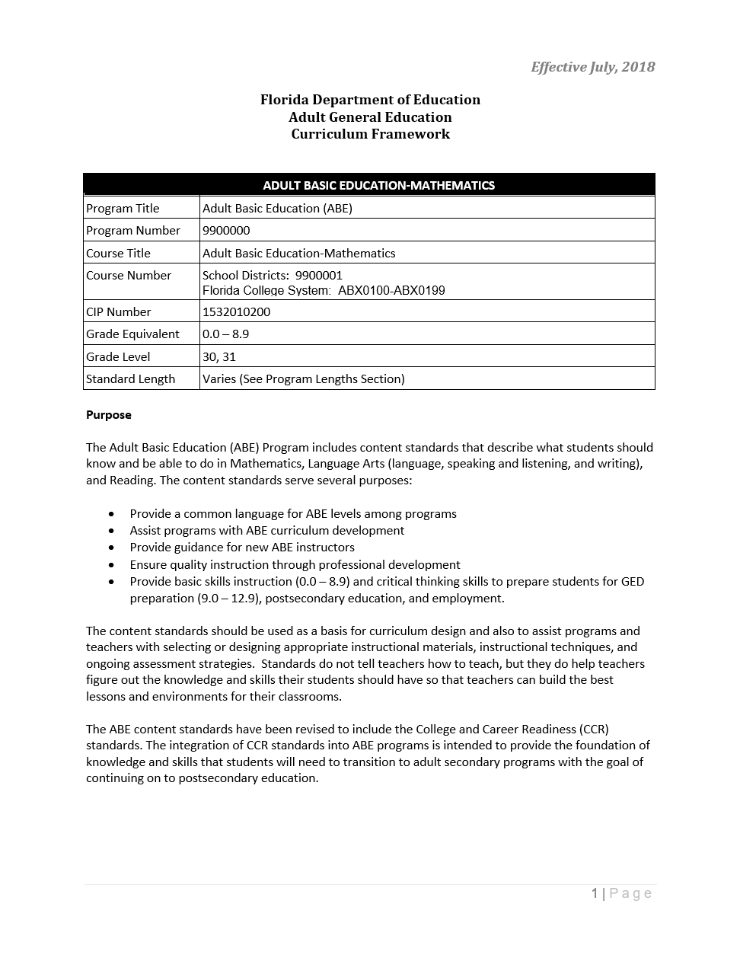
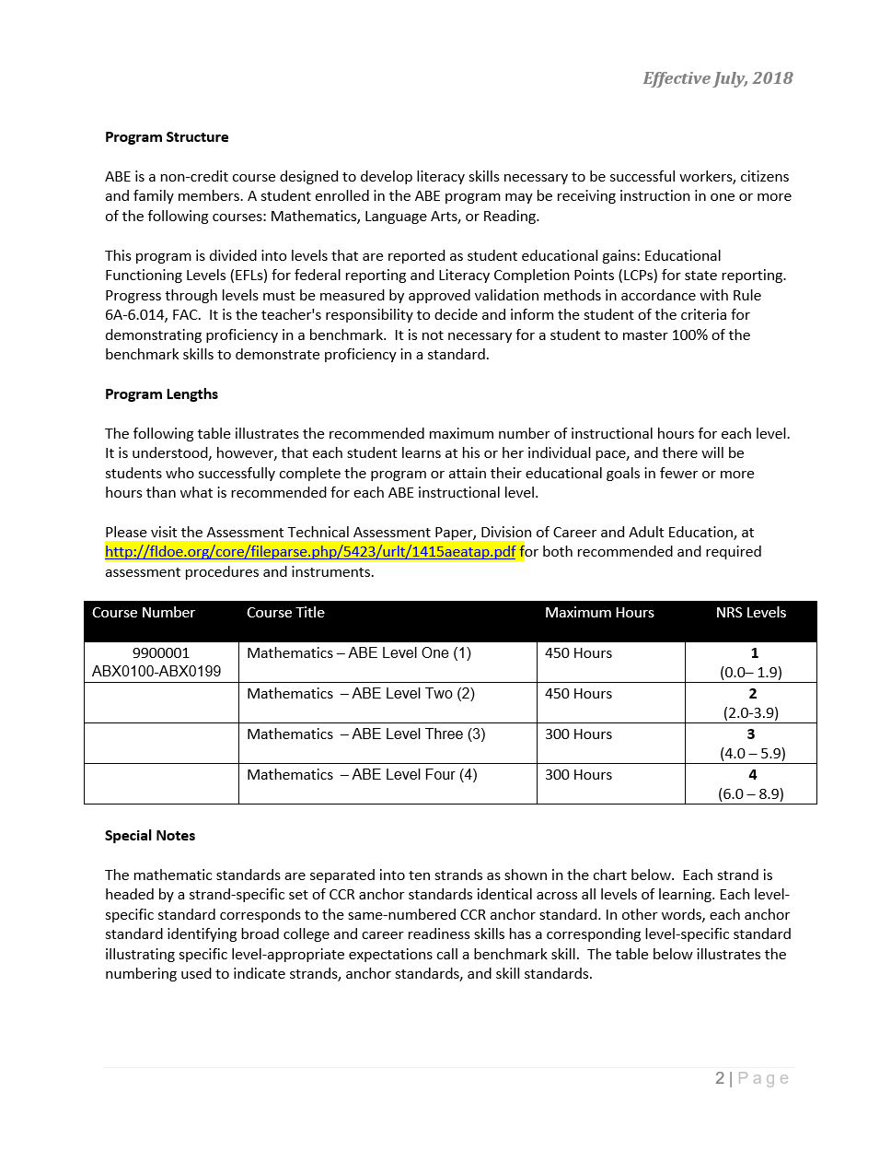
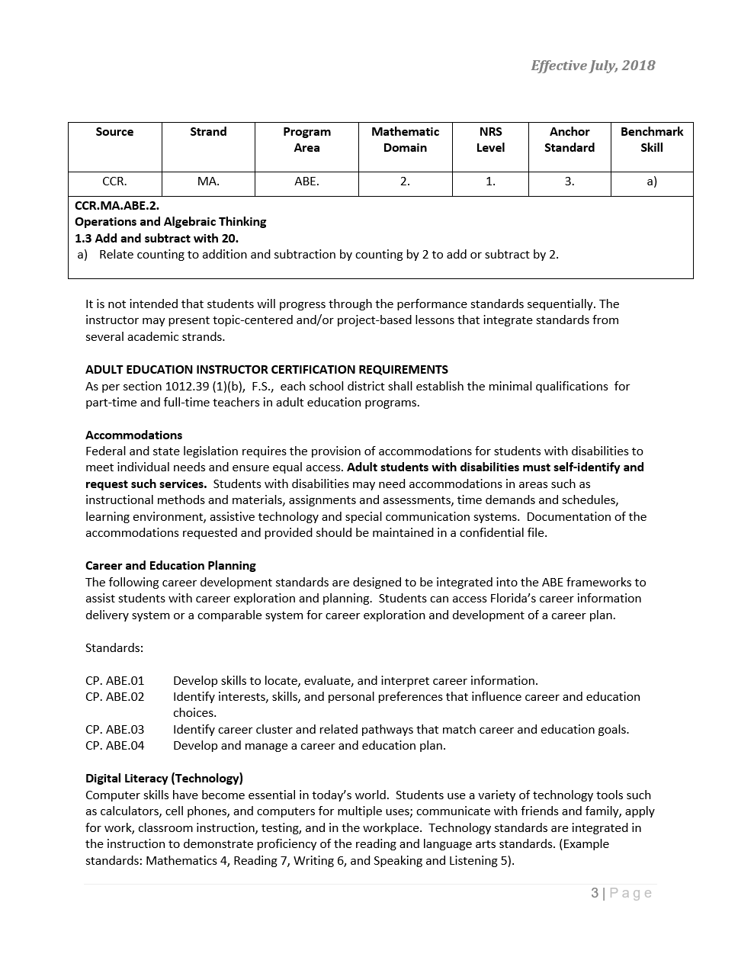
Curriculum Frameworks
BY EDUCATORS FOR EDUCATORS
The ABE Mathematics Curriculum Frameworks
Notes:
The Florida Department of Education has provided us with curriculum frameworks that would allow each school district, college or other educational institutions to develop their own curricula. This slide shows how the Curriculum Frameworks for ABE Mathematics looks like.

Slide 14
Purpose
BY EDUCATORS FOR EDUCATORS
The Adult Basic Education (ABE) Program includes content standards that describe what students should know and be able to do in Mathematics. The content standards serve several purposes:
Provide a common language for ABE levels among programs
Assist programs with ABE curriculum development
Provide guidance for new ABE instructors
Ensure quality instruction through professional development
Provide basic skills instruction (0.0 – 8.9) and critical thinking skills to prepare students for GED preparation (9.0 – 12.9), postsecondary education, and employment.
Notes:
Explain the purpose of ABE Mathematics Curriculum Frameworks.

Slide 15
Purpose
Workbook p. 2
The content standards should be used as a basis for curriculum design and also to assist programs and teachers with selecting or designing:
  appropriate instructional materials
  instructional techniques, and
  ongoing assessment strategies.
Standards DO NOT tell teachers how to teach, but they do help teachers figure out the knowledge and skills their students should have so that teachers can build the best lessons and environments for their classrooms.
15
2017-18 The Institute for the Professional Development of Adult Educators
Notes:
Continue to explain the purpose of ABE Mathematics Curriculum Frameworks.

Slide 16
Curriculum Frameworks
BY EDUCATORS FOR EDUCATORS
The ABE Mathematics Curriculum Frameworks
31 Pages
10 Mathematics Domains
79 Content Standards
294 Content Benchmarks
4 Career and Education Planning Standards
4 Digital Literacy (Technology) Standards
7 Workforce Preparation Activities
Notes:
Go over the features of the ABE Mathematics Curriculum Frameworks.

Slide 17
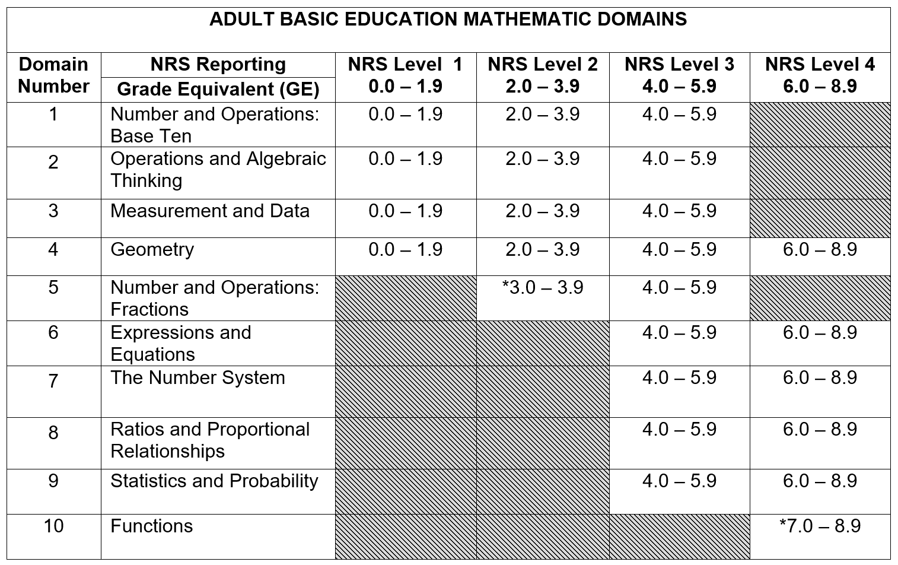
Curriculum Frameworks
BY EDUCATORS FOR EDUCATORS
The ABE Mathematics Domains
Notes:
The curriculum frameworks provides us with a mapping of all the CCRS Mathematics Domains and spanning across all levels of ABE. However, this only provides little information as to what standards and objectives have to be taught to ABE students. We have to look at the individual standards to gain a better understanding of what we are required to teach.

Slide 18
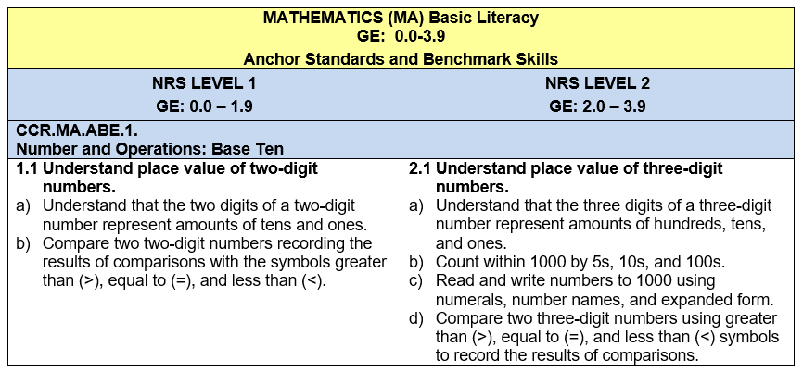
Curriculum Frameworks
BY EDUCATORS FOR EDUCATORS
The ABE Mathematics Standards
ABE Level
Domain
Anchor Standards
Benchmark Skills
This formatting and arrangement of math standards and benchmark skills span 25 pages of the ABE Mathematics Curriculum Frameworks.
Notes:
Explain each part of the ABE Math Standards. Explain that one of the main reasons why the Curriculum Matrix was developed is to summarize the curriculum frameworks in a visual representation, leading to a better understanding as to how standards relate to each other.

Slide 19
The ABE Mathematics Curriculum Matrix was developed directly from the ABE Mathematics Curriculum Frameworks released by the Florida Department of Education.
19
2017-18 The Institute for the Professional Development of Adult Educators
Notes:
Ask one of the participants to read this slide while the rest reads silently.

Slide 20
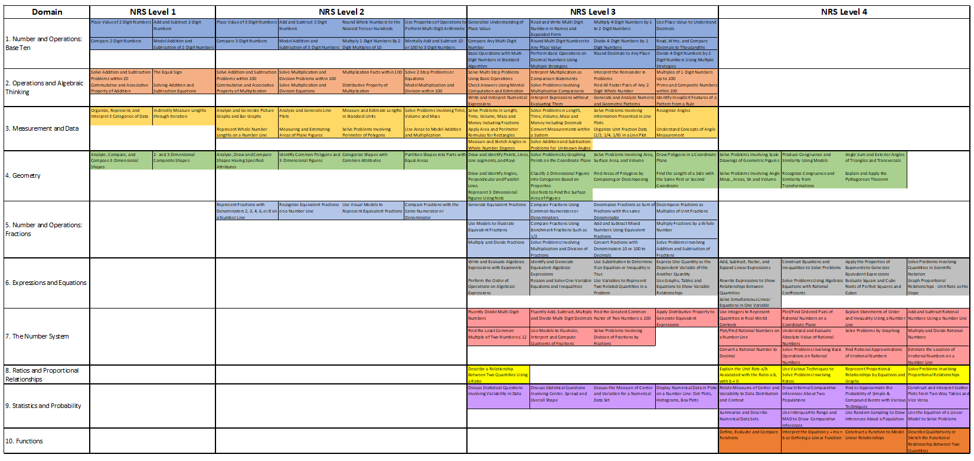
THE ABE Mathematics curriculum matrix
20
2017-18 The Institute for the Professional Development of Adult Educators
Notes:
Transition slide for presenting the ABE Mathematics Curriculum Matrix.

Slide 21


How to Download
Workbook p. 2
floridaipdae.org
21
2017-18 The Institute for the Professional Development of Adult Educators
Notes:
The next few slides will demonstrate how to download the electronic copy of the ABE Mathematics Curriculum Matrix.
Type www.floridaipdae.org on the address bar of any browser.
Click on the ABE Tab.
Click on the Webinar Channel.

Slide 22
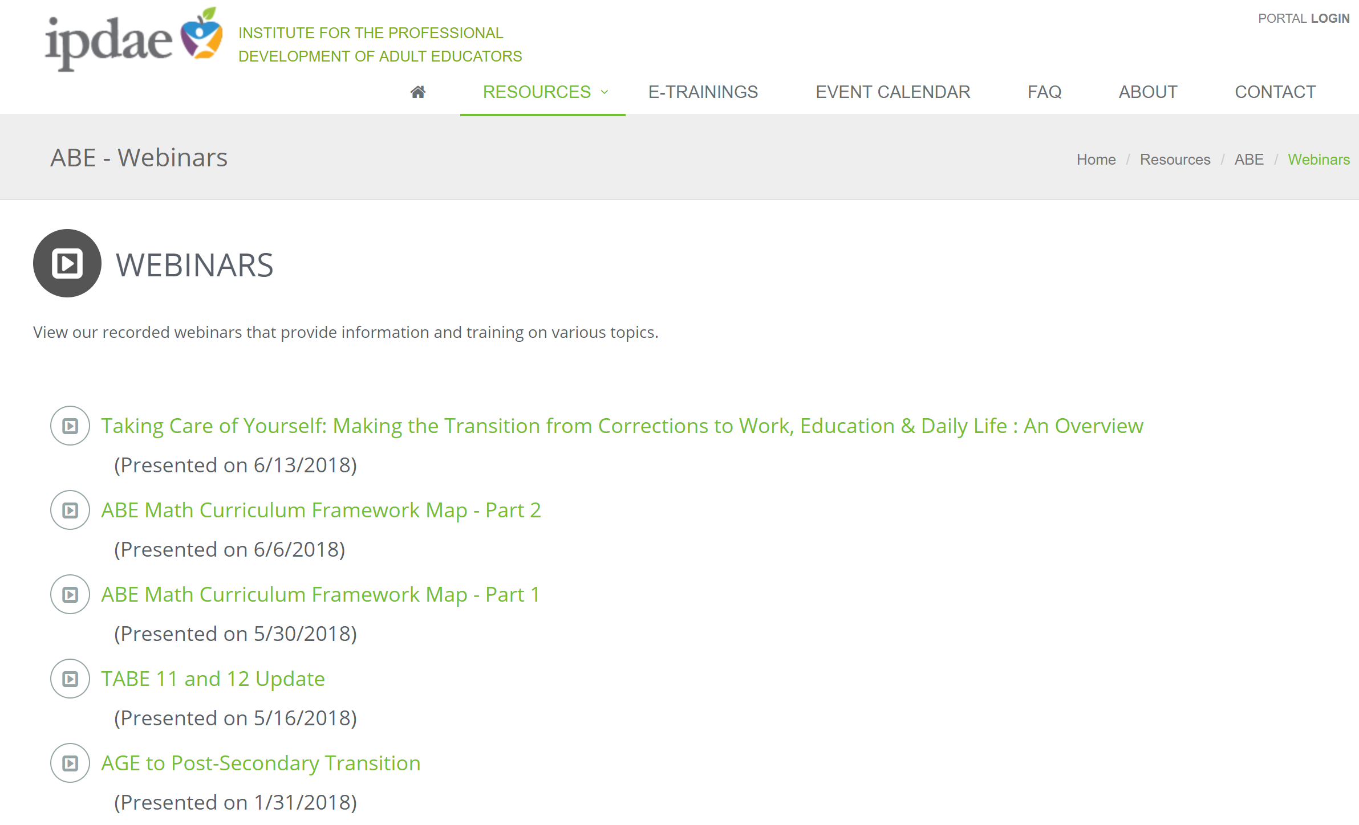
How to Download
Workbook p. 2
22
2017-18 The Institute for the Professional Development of Adult Educators
Notes:
Look for the ABE Math Curriculum Framework Map Webinar Part 1 or Part 2.

Slide 23
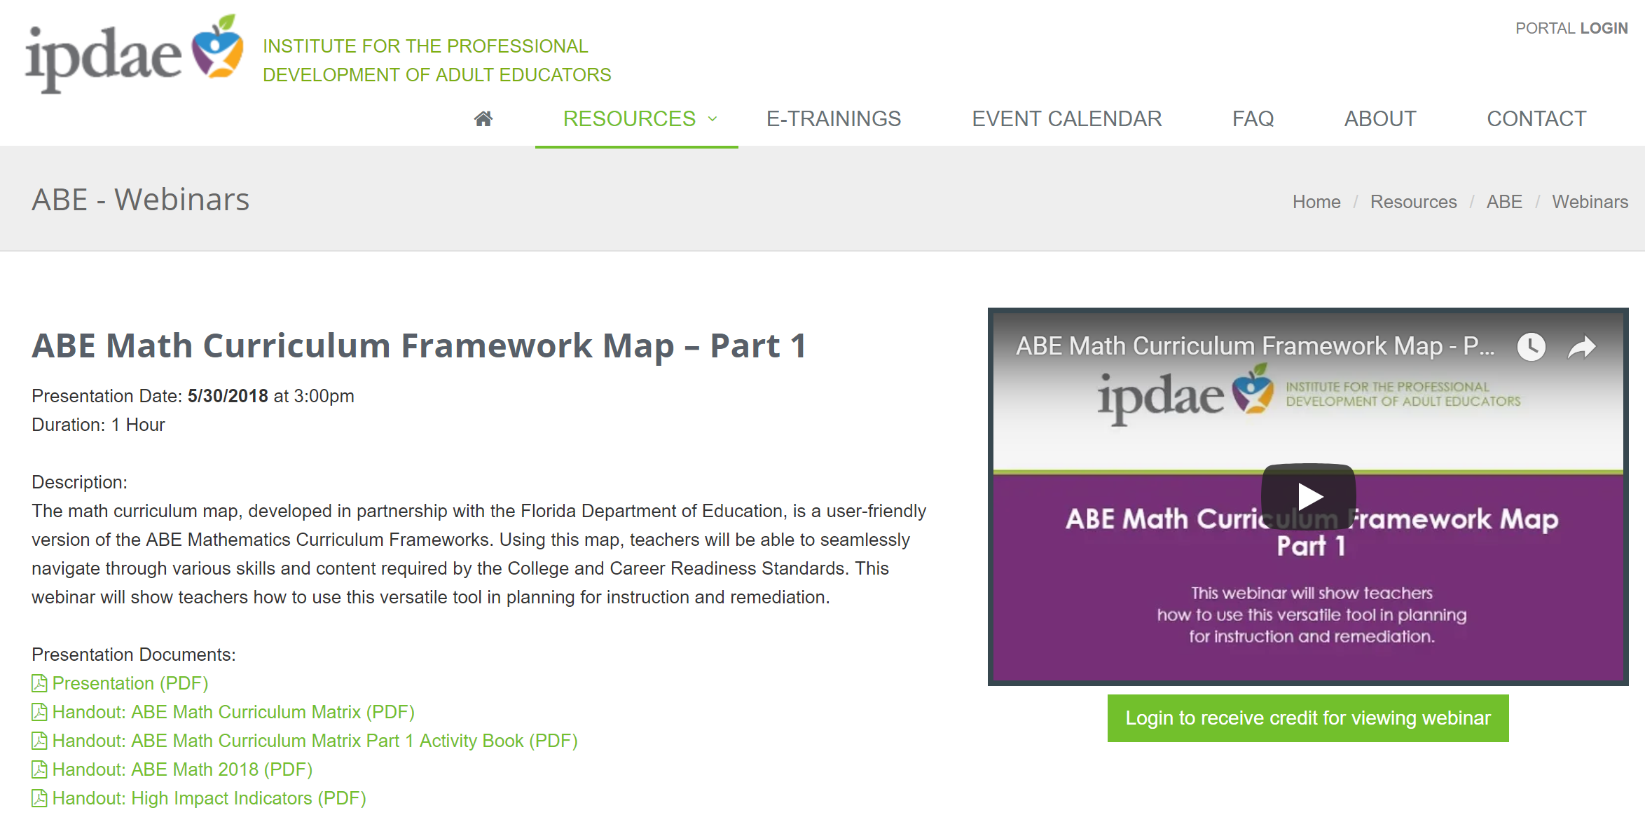
How to Download
Workbook p. 2
23
2017-18 The Institute for the Professional Development of Adult Educators
Notes:
On the Presentation Documents Section of the page, click on Handout: ABE Math Curriculum Matrix (PDF). Teachers may save this PDF version so they can easily it at any time.

Slide 24
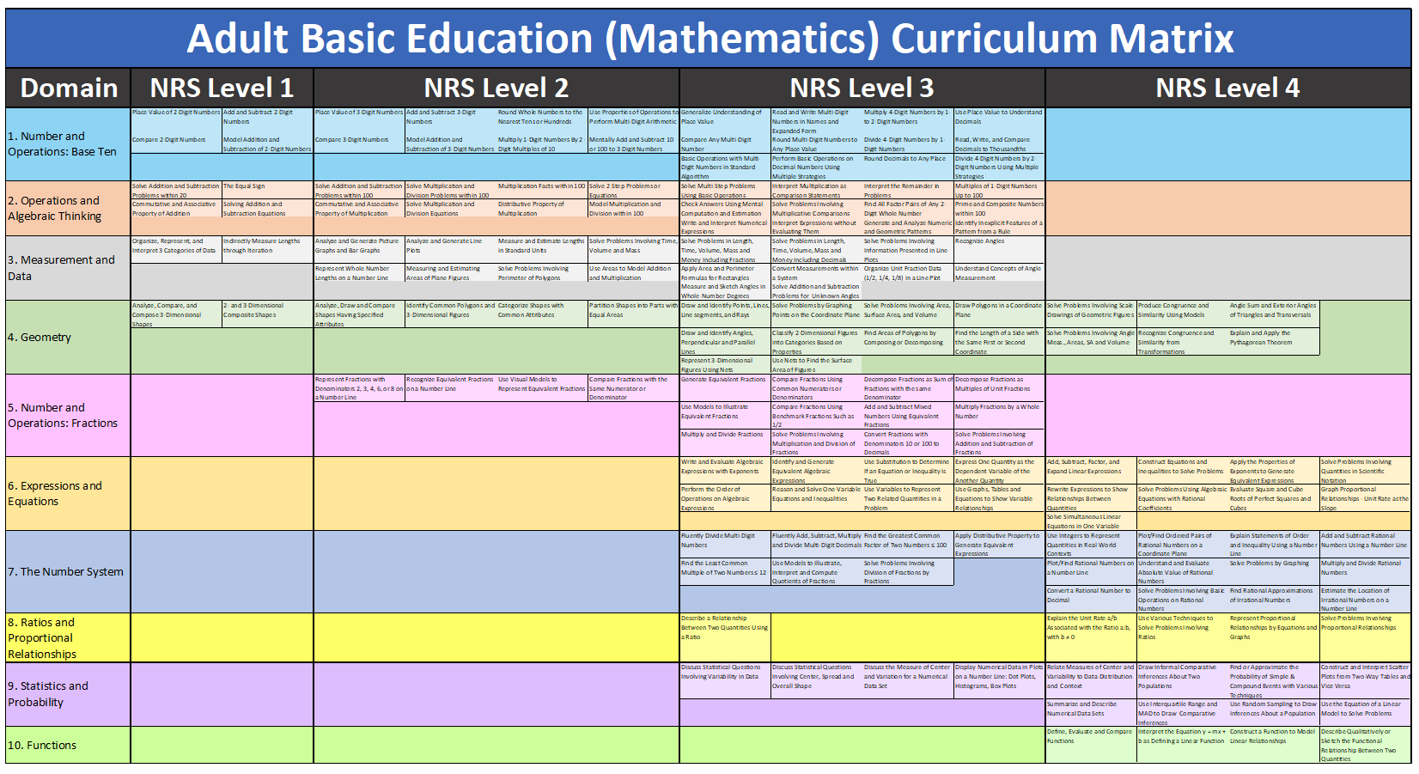
Versions of Matrix
Workbook p. 2
Original Version
24
2017-18 The Institute for the Professional Development of Adult Educators
Notes:
This version of the matrix is the original version. This is the printed version used for face-to-face workshops or presentations. This is also the format of the electronic version that can be downloaded from the IPDAE website.

Slide 25
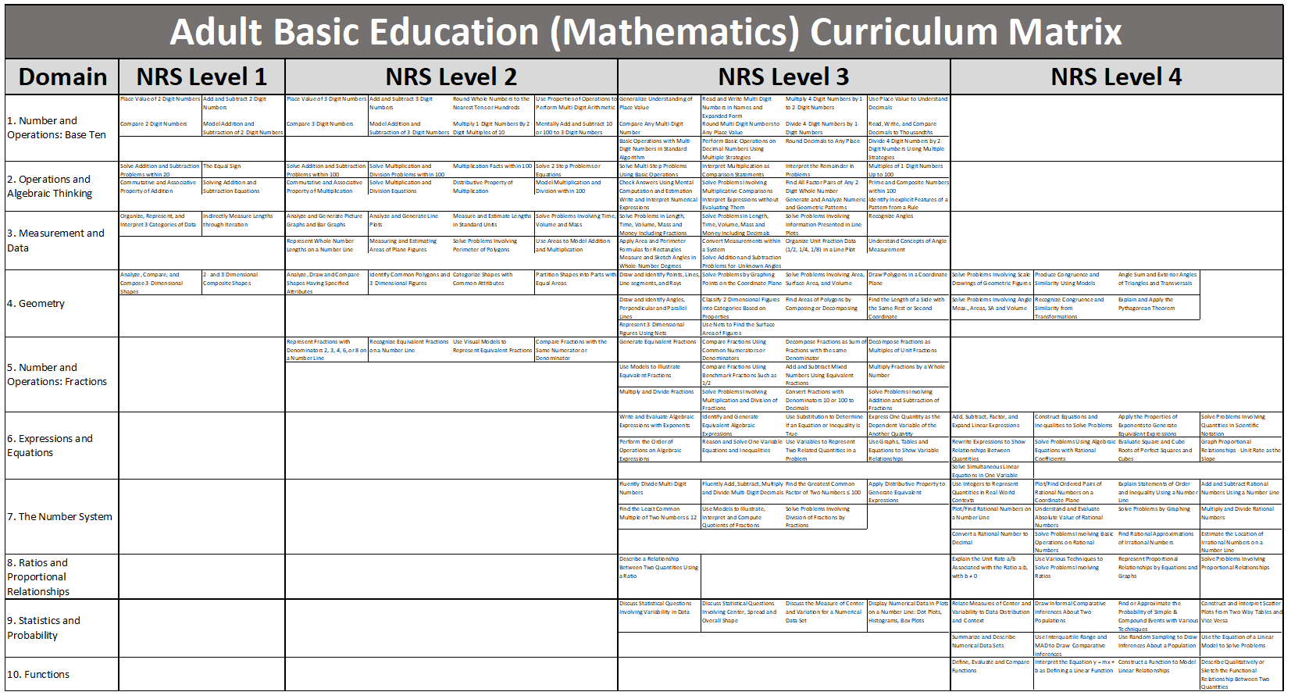
Versions of Matrix
Workbook p. 2
Plain (Grayscale) Version
25
2017-18 The Institute for the Professional Development of Adult Educators
Notes:
This version is the version that teachers will be able to use more often because it can be customized for various applications in the classroom.

Slide 26
Versions of Matrix
Workbook p. 2
Presentation Version
26
2017-18 The Institute for the Professional Development of Adult Educators
Notes:
This version is what you will mostly see in this presentation. This is also called the BETA Version. Some teachers may have received this version in earlier mathematics workshops.

Slide 27
Layout of the Matrix
Workbook p. 2
Domains
NRS Levels
163 Content Cells
The intersection between a domain and level is referred as a region in the matrix.
27
2017-18 The Institute for the Professional Development of Adult Educators
Notes:
This slide is animated. Every click points a feature of the matrix.
Point out where teachers can see the 10 mathematics domains, the NRS levels, the content cells and the content regions.

Slide 28
ABE Levels
Workbook p. 2
What are NRS Levels?
NRS stands for National Reporting System. The NRS divides Adult Basic Education into 4 levels:
Level 1 – Literacy (Grade Equivalent 0 to 1)
Level 2 – Beginning Basic (Grade Equivalent 2 to 3)
Level 3 – Low Intermediate (Grade Equivalent 4 to 5)
Level 4 – High Intermediate (Grade Equivalent 6 to 8)
Levels 5 and 6 are levels that belong to Adult Secondary Education (GED Prep):
Level 5 – Low Adult Secondary Education (Grade 9 – 10)
Level 6 – High Adult Secondary Education (Grade 11 – 12)
28
2017-18 The Institute for the Professional Development of Adult Educators
Notes:
Teachers do not necessarily understand what NRS levels are. Use this slide to explain the meaning of NRS Levels. Please note that the matrix only contains levels 1 through 4 since the matrix was developed for Adult Basic Education (ABE). Future matrices may be developed for Adult Secondary Education.

Slide 29
It’s a Continuum
Mathematics
Beginning Adult Basic Education Literacy (GE 0.0-1.9)
Low and High Adult Secondary Education
(GE 9.0-12.9)
Low Intermediate Basic Education (GE 4.0-5.9)
College and Career Readiness
Beginning Basic Education
(GE 2.0-3.9)
High Intermediate Basic Education (GE 6.0-8.9)
29
©2014 IPDAE. All rights reserved. All content in this presentation is the proprietary property of The Institute for the Professional Development of Adult Educators
Notes:
29
This slide shows a more visual representation of the ABE and GED Levels.

Slide 30
Statistics NRS Level 3
BY EDUCATORS FOR EDUCATORS
3.1 Develop understanding of statistical variability. Discuss a statistical question as one that anticipates variability in the data related to the question and accounts for it in the answers. Discuss a set of data collected to answer a statistical question has a distribution which can be described by its center, spread, and overall shape. Discuss that a measure of center for a numerical data set summarizes all of its values with a single number, while a measure of variation describes how its values vary with a single number.
3.2 Summarize and describe distributions. Display numerical data in plots on a number line, including: Dot plots (graph of data using dots). Histograms (bar graph using ranges of data). Box plots (graph uses rectangles with lines extending from the top and bottom).
This slide shows how each cell in the Curriculum Matrix was derived directly from the ABE Math Curriculum Frameworks.
Notes:
This slide shows how the ABE Mathematics Curriculum Matrix was derived from the ABE Mathematics Curriculum Frameworks. In this slide, the Statistics NRS level 3 region is shown. Note that certain benchmark skills and/or standards are more often combined into one content cell or less often separated into multiple content cells. The wording was also simplified in order to fit a single page matrix printout.

Slide 31
CCRS
BY EDUCATORS FOR EDUCATORS
Conceptual Understanding
Domain | NRS Level 1 |  | NRS Level 2 |  |  |  | NRS Level 3 |  |  |  | NRS Level 4
1. Number and Operations: Base Ten | Place Value of 2-Digit Numbers | Add and Subtract 2-Digit Numbers | Place Value of 3-Digit Numbers | Add and Subtract 3-Digit Numbers | Round Whole Numbers to the Nearest Tens or Hundreds | Use Properties of Operations to Perform Multi-Digit Arithmetic | Generalize Understanding of Place Value | Read and Write Multi-Digit Numbers in Names and Expanded Form | Multiply 4-Digit Numbers by 1- to 2-Digit Numbers | Use Place Value to Understand Decimals
 | Compare 2-Digit Numbers | Model Addition and Subtraction of 2-Digit Numbers | Compare 3-Digit Numbers | Model Addition and Subtraction of 3-Digit Numbers | Multiply 1-Digit Numbers By 2-Digit Multiples of 10 | Mentally Add and Subtract 10 or 100 to 3-Digit Numbers | Compare Any Multi-Digit Number | Round Multi-Digit Numbers to Any Place Value | Divide 4-Digit Numbers by 1-Digit Numbers | Read, Write, and Compare Decimals to Thousandths
 |  |  |  |  |  |  | Basic Operations with Multi-Digit Numbers in Standard Algorithm | Perform Basic Operations on Decimal Numbers Using Multiple Strategies | Round Decimals to Any Place | Divide 4-Digit Numbers by 2-Digit Numbers Using Multiple Strategies
2. Operations and Algebraic Thinking | Solve Addition and Subtraction Problems within 20 | The Equal Sign | Solve Addition and Subtraction Problems within 100 | Solve Multiplication and Division Problems within 100 | Multiplication Facts within 100 | Solve 2-Step Problems or Equations | Solve Multi-Step Problems Using Basic Operations | Interpret Multiplication as Comparison Statements | Interpret the Remainder in Problems | Multiples of 1-Digit Numbers Up to 100
 | Commutative and Associative Property of Addition | Solving Addition and Subtraction Equations | Commutative and Associative Property of Multiplication | Solve Multiplication and Division Equations | Distributive Property of Multiplication | Model Multiplication and Division within 100 | Check Answers Using Mental Computation and Estimation | Solve Problems Involving Multiplicative Comparisons | Find All Factor Pairs of Any 2-Digit Whole Number | Prime and Composite Numbers within 100
 |  |  |  |  |  |  | Write and Interpret Numerical Expressions | Interpret Expressions without Evaluating Them | Generate and Analyze Numeric and Geometric Patterns | Identify Inexplicit Features of a Pattern from a Rule
3. Measurement and Data | Organize, Represent, and Interpret 3 Categories of Data | Indirectly Measure Lengths through Iteration | Analyze and Generate Picture Graphs and Bar Graphs | Analyze and Generate Line Plots | Measure and Estimate Lengths in Standard Units | Solve Problems Involving Time, Volume and Mass | Solve Problems in Length, Time, Volume, Mass and Money Including Fractions | Solve Problems in Length, Time, Volume, Mass and Money Including Decimals | Solve Problems Involving Information Presented in Line Plots | Recognize Angles
 |  |  | Represent Whole Number Lengths on a Number Line | Measuring and Estimating Areas of Plane Figures | Solve Problems Involving Perimeter of Polygons | Use Areas to Model Addition and Multiplication | Apply Area and Perimeter Formulas for Rectangles | Convert Measurements within a System | Organize Unit Fraction Data (1/2, 1/4, 1/8) in a Line Plot | Understand Concepts of Angle Measurement
 |  |  |  |  |  |  | Measure and Sketch Angles in Whole-Number Degrees | Solve Addition and Subtraction Problems for Unknown Angles
4. Geometry | Analyze, Compare, and Compose 3-Dimensional Shapes | 2- and 3-Dimensional Composite Shapes | Analyze, Draw and Compare Shapes Having Specified Attributes | Identify Common Polygons and 3-Dimensional Figures | Categorize Shapes with Common Attributes | Partition Shapes into Parts with Equal Areas | Draw and Identify Points, Lines, Line segments, and Rays | Solve Problems by Graphing Points on the Coordinate Plane | Solve Problems Involving Area, Surface Area, and Volume | Draw Polygons in a Coordinate Plane | Solve Problems Involving Scale Drawings of Geometric Figures | Produce Congruence and Similarity Using Models | Angle Sum and Exterior Angles of Triangles and Transversals
 |  |  |  |  |  |  | Draw and Identify Angles, Perpendicular and Parallel Lines | Classify 2-Dimensional Figures into Categories Based on Properties | Find Areas of Polygons by Composing or Decomposing | Find the Length of a Side with the Same First or Second Coordinate | Solve Problems Involving Angle Meas., Areas, SA and Volume | Recognize Congruence and Similarity from Transformations | Explain and Apply the Pythagorean Theorem
 |  |  |  |  |  |  | Represent 3-Dimensional Figures Using Nets | Use Nets to Find the Surface Area of Figures
5. Number and Operations: Fractions |  |  | Represent Fractions with Denominators 2, 3, 4, 6, or 8 on a Number Line | Recognize Equivalent Fractions on a Number Line | Use Visual Models to Represent Equivalent Fractions | Compare Fractions with the Same Numerator or Denominator | Generate Equivalent Fractions | Compare Fractions Using Common Numerators or Denominators | Decompose Fractions as Sum of Fractions with the same Denominator | Decompose Fractions as Multiples of Unit Fractions
 |  |  |  |  |  |  | Use Models to Illustrate Equivalent Fractions | Compare Fractions Using Benchmark Fractions Such as 1/2 | Add and Subtract Mixed Numbers Using Equivalent Fractions | Multiply Fractions by a Whole Number
 |  |  |  |  |  |  | Multiply and Divide Fractions | Solve Problems Involving Multiplication and Division of Fractions | Convert Fractions with Denominators 10 or 100 to Decimals | Solve Problems Involving Addition and Subtraction of Fractions
6. Expressions and Equations |  |  |  |  |  |  | Write and Evaluate Algebraic Expressions with Exponents | Identify and Generate Equivalent Algebraic Expressions | Use Substitution to Determine If an Equation or Inequality is True | Express One Quantity as the Dependent Variable of the Another Quantity | Add, Subtract, Factor, and Expand Linear Expressions | Construct Equations and Inequalities to Solve Problems | Apply the Properties of Exponents to Generate Equivalent Expressions | Solve Problems Involving Quantities in Scientific Notation
 |  |  |  |  |  |  | Perform the Order of Operations on Algebraic Expressions | Reason and Solve One-Variable Equations and Inequalities | Use Variables to Represent Two Related Quantities in a Problem | Use Graphs, Tables and Equations to Show Variable Relationships | Rewrite Expressions to Show Relationships Between Quantities | Solve Problems Using Algebraic Equations with Rational Coefficients | Evaluate Square and Cube Roots of Perfect Squares and Cubes | Graph Proportional Relationships - Unit Rate as the Slope
 |  |  |  |  |  |  |  |  |  |  | Solve Simultaneous Linear Equations in One Variable
7. The Number System |  |  |  |  |  |  | Fluently Divide Multi-Digit Numbers | Fluently Add, Subtract, Multiply and Divide Multi-Digit Decimals | Find the Greatest Common Factor of Two Numbers ≤ 100 | Apply Distributive Property to Generate Equivalent Expressions | Use Integers to Represent Quantities in Real-World Contexts | Plot/Find Ordered Pairs of Rational Numbers on a Coordinate Plane | Explain Statements of Order and Inequality Using a Number Line | Add and Subtract Rational Numbers Using a Number Line
 |  |  |  |  |  |  | Find the Least Common Multiple of Two Numbers ≤ 12 | Use Models to Illustrate, Interpret and Compute Quotients of Fractions | Solve Problems Involving Division of Fractions by Fractions |  | Plot/Find Rational Numbers on a Number Line | Understand and Evaluate Absolute Value of Rational Numbers | Solve Problems by Graphing | Multiply and Divide Rational Numbers
 |  |  |  |  |  |  |  |  |  |  | Convert a Rational Number to Decimal | Solve Problems Involving Basic Operations on Rational Numbers | Find Rational Approximations of Irrational Numbers | Estimate the Location of Irrational Numbers on a Number Line
8. Ratios and Proportional Relationships |  |  |  |  |  |  | Describe a Relationship Between Two Quantities Using a Ratio |  |  |  | Explain the Unit Rate a/b Associated with the Ratio a:b, with b ≠ 0 | Use Various Techniques to Solve Problems Involving Ratios | Represent Proportional Relationships by Equations and Graphs | Solve Problems Involving Proportional Relationships
9. Statistics and Probability |  |  |  |  |  |  | Discuss Statistical Questions Involving Variability in Data | Discuss Statistical Questions Involving Center, Spread and Overall Shape | Discuss the Measure of Center and Variation for a Numerical Data Set | Display Numerical Data in Plots on a Number Line: Dot Plots, Histograms, Box Plots | Relate Measures of Center and Variability to Data Distribution and Context | Draw Informal Comparative Inferences About Two Populations | Find or Approximate the Probability of Simple & Compound Events with Various Techniques | Construct and Interpret Scatter Plots from Two-Way Tables and Vice Versa
 |  |  |  |  |  |  |  |  |  |  | Summarize and Describe Numerical Data Sets | Use Interquartile Range and MAD to Draw Comparative Inferences | Use Random Sampling to Draw Inferences About a Population | Use the Equation of a Linear Model to Solve Problems
10. Functions |  |  |  |  |  |  |  |  |  |  | Define, Evaluate and Compare Functions | Interpret the Equation y = mx + b as Defining a Linear Function | Construct a Function to Model Linear Relationships | Describe Qualitatively or Sketch the Functional Relationship Between Two Quantities
Notes:
Using the matrix, teachers can clearly see which domains apply to each component of rigor, a key shift in the College and Career Readiness Standards. This slide shows domains 1, 2, 6, 8, and 10 focus on conceptual understanding according to CCRS.

Slide 32
CCRS
BY EDUCATORS FOR EDUCATORS
Procedural Fluency
Domain | NRS Level 1 |  | NRS Level 2 |  |  |  | NRS Level 3 |  |  |  | NRS Level 4
1. Number and Operations: Base Ten | Place Value of 2-Digit Numbers | Add and Subtract 2-Digit Numbers | Place Value of 3-Digit Numbers | Add and Subtract 3-Digit Numbers | Round Whole Numbers to the Nearest Tens or Hundreds | Use Properties of Operations to Perform Multi-Digit Arithmetic | Generalize Understanding of Place Value | Read and Write Multi-Digit Numbers in Names and Expanded Form | Multiply 4-Digit Numbers by 1- to 2-Digit Numbers | Use Place Value to Understand Decimals
 | Compare 2-Digit Numbers | Model Addition and Subtraction of 2-Digit Numbers | Compare 3-Digit Numbers | Model Addition and Subtraction of 3-Digit Numbers | Multiply 1-Digit Numbers By 2-Digit Multiples of 10 | Mentally Add and Subtract 10 or 100 to 3-Digit Numbers | Compare Any Multi-Digit Number | Round Multi-Digit Numbers to Any Place Value | Divide 4-Digit Numbers by 1-Digit Numbers | Read, Write, and Compare Decimals to Thousandths
 |  |  |  |  |  |  | Basic Operations with Multi-Digit Numbers in Standard Algorithm | Perform Basic Operations on Decimal Numbers Using Multiple Strategies | Round Decimals to Any Place | Divide 4-Digit Numbers by 2-Digit Numbers Using Multiple Strategies
2. Operations and Algebraic Thinking | Solve Addition and Subtraction Problems within 20 | The Equal Sign | Solve Addition and Subtraction Problems within 100 | Solve Multiplication and Division Problems within 100 | Multiplication Facts within 100 | Solve 2-Step Problems or Equations | Solve Multi-Step Problems Using Basic Operations | Interpret Multiplication as Comparison Statements | Interpret the Remainder in Problems | Multiples of 1-Digit Numbers Up to 100
 | Commutative and Associative Property of Addition | Solving Addition and Subtraction Equations | Commutative and Associative Property of Multiplication | Solve Multiplication and Division Equations | Distributive Property of Multiplication | Model Multiplication and Division within 100 | Check Answers Using Mental Computation and Estimation | Solve Problems Involving Multiplicative Comparisons | Find All Factor Pairs of Any 2-Digit Whole Number | Prime and Composite Numbers within 100
 |  |  |  |  |  |  | Write and Interpret Numerical Expressions | Interpret Expressions without Evaluating Them | Generate and Analyze Numeric and Geometric Patterns | Identify Inexplicit Features of a Pattern from a Rule
3. Measurement and Data | Organize, Represent, and Interpret 3 Categories of Data | Indirectly Measure Lengths through Iteration | Analyze and Generate Picture Graphs and Bar Graphs | Analyze and Generate Line Plots | Measure and Estimate Lengths in Standard Units | Solve Problems Involving Time, Volume and Mass | Solve Problems in Length, Time, Volume, Mass and Money Including Fractions | Solve Problems in Length, Time, Volume, Mass and Money Including Decimals | Solve Problems Involving Information Presented in Line Plots | Recognize Angles
 |  |  | Represent Whole Number Lengths on a Number Line | Measuring and Estimating Areas of Plane Figures | Solve Problems Involving Perimeter of Polygons | Use Areas to Model Addition and Multiplication | Apply Area and Perimeter Formulas for Rectangles | Convert Measurements within a System | Organize Unit Fraction Data (1/2, 1/4, 1/8) in a Line Plot | Understand Concepts of Angle Measurement
 |  |  |  |  |  |  | Measure and Sketch Angles in Whole-Number Degrees | Solve Addition and Subtraction Problems for Unknown Angles
4. Geometry | Analyze, Compare, and Compose 3-Dimensional Shapes | 2- and 3-Dimensional Composite Shapes | Analyze, Draw and Compare Shapes Having Specified Attributes | Identify Common Polygons and 3-Dimensional Figures | Categorize Shapes with Common Attributes | Partition Shapes into Parts with Equal Areas | Draw and Identify Points, Lines, Line segments, and Rays | Solve Problems by Graphing Points on the Coordinate Plane | Solve Problems Involving Area, Surface Area, and Volume | Draw Polygons in a Coordinate Plane | Solve Problems Involving Scale Drawings of Geometric Figures | Produce Congruence and Similarity Using Models | Angle Sum and Exterior Angles of Triangles and Transversals
 |  |  |  |  |  |  | Draw and Identify Angles, Perpendicular and Parallel Lines | Classify 2-Dimensional Figures into Categories Based on Properties | Find Areas of Polygons by Composing or Decomposing | Find the Length of a Side with the Same First or Second Coordinate | Solve Problems Involving Angle Meas., Areas, SA and Volume | Recognize Congruence and Similarity from Transformations | Explain and Apply the Pythagorean Theorem
 |  |  |  |  |  |  | Represent 3-Dimensional Figures Using Nets | Use Nets to Find the Surface Area of Figures
5. Number and Operations: Fractions |  |  | Represent Fractions with Denominators 2, 3, 4, 6, or 8 on a Number Line | Recognize Equivalent Fractions on a Number Line | Use Visual Models to Represent Equivalent Fractions | Compare Fractions with the Same Numerator or Denominator | Generate Equivalent Fractions | Compare Fractions Using Common Numerators or Denominators | Decompose Fractions as Sum of Fractions with the same Denominator | Decompose Fractions as Multiples of Unit Fractions
 |  |  |  |  |  |  | Use Models to Illustrate Equivalent Fractions | Compare Fractions Using Benchmark Fractions Such as 1/2 | Add and Subtract Mixed Numbers Using Equivalent Fractions | Multiply Fractions by a Whole Number
 |  |  |  |  |  |  | Multiply and Divide Fractions | Solve Problems Involving Multiplication and Division of Fractions | Convert Fractions with Denominators 10 or 100 to Decimals | Solve Problems Involving Addition and Subtraction of Fractions
6. Expressions and Equations |  |  |  |  |  |  | Write and Evaluate Algebraic Expressions with Exponents | Identify and Generate Equivalent Algebraic Expressions | Use Substitution to Determine If an Equation or Inequality is True | Express One Quantity as the Dependent Variable of the Another Quantity | Add, Subtract, Factor, and Expand Linear Expressions | Construct Equations and Inequalities to Solve Problems | Apply the Properties of Exponents to Generate Equivalent Expressions | Solve Problems Involving Quantities in Scientific Notation
 |  |  |  |  |  |  | Perform the Order of Operations on Algebraic Expressions | Reason and Solve One-Variable Equations and Inequalities | Use Variables to Represent Two Related Quantities in a Problem | Use Graphs, Tables and Equations to Show Variable Relationships | Rewrite Expressions to Show Relationships Between Quantities | Solve Problems Using Algebraic Equations with Rational Coefficients | Evaluate Square and Cube Roots of Perfect Squares and Cubes | Graph Proportional Relationships - Unit Rate as the Slope
 |  |  |  |  |  |  |  |  |  |  | Solve Simultaneous Linear Equations in One Variable
7. The Number System |  |  |  |  |  |  | Fluently Divide Multi-Digit Numbers | Fluently Add, Subtract, Multiply and Divide Multi-Digit Decimals | Find the Greatest Common Factor of Two Numbers ≤ 100 | Apply Distributive Property to Generate Equivalent Expressions | Use Integers to Represent Quantities in Real-World Contexts | Plot/Find Ordered Pairs of Rational Numbers on a Coordinate Plane | Explain Statements of Order and Inequality Using a Number Line | Add and Subtract Rational Numbers Using a Number Line
 |  |  |  |  |  |  | Find the Least Common Multiple of Two Numbers ≤ 12 | Use Models to Illustrate, Interpret and Compute Quotients of Fractions | Solve Problems Involving Division of Fractions by Fractions |  | Plot/Find Rational Numbers on a Number Line | Understand and Evaluate Absolute Value of Rational Numbers | Solve Problems by Graphing | Multiply and Divide Rational Numbers
 |  |  |  |  |  |  |  |  |  |  | Convert a Rational Number to Decimal | Solve Problems Involving Basic Operations on Rational Numbers | Find Rational Approximations of Irrational Numbers | Estimate the Location of Irrational Numbers on a Number Line
8. Ratios and Proportional Relationships |  |  |  |  |  |  | Describe a Relationship Between Two Quantities Using a Ratio |  |  |  | Explain the Unit Rate a/b Associated with the Ratio a:b, with b ≠ 0 | Use Various Techniques to Solve Problems Involving Ratios | Represent Proportional Relationships by Equations and Graphs | Solve Problems Involving Proportional Relationships
9. Statistics and Probability |  |  |  |  |  |  | Discuss Statistical Questions Involving Variability in Data | Discuss Statistical Questions Involving Center, Spread and Overall Shape | Discuss the Measure of Center and Variation for a Numerical Data Set | Display Numerical Data in Plots on a Number Line: Dot Plots, Histograms, Box Plots | Relate Measures of Center and Variability to Data Distribution and Context | Draw Informal Comparative Inferences About Two Populations | Find or Approximate the Probability of Simple & Compound Events with Various Techniques | Construct and Interpret Scatter Plots from Two-Way Tables and Vice Versa
 |  |  |  |  |  |  |  |  |  |  | Summarize and Describe Numerical Data Sets | Use Interquartile Range and MAD to Draw Comparative Inferences | Use Random Sampling to Draw Inferences About a Population | Use the Equation of a Linear Model to Solve Problems
10. Functions |  |  |  |  |  |  |  |  |  |  | Define, Evaluate and Compare Functions | Interpret the Equation y = mx + b as Defining a Linear Function | Construct a Function to Model Linear Relationships | Describe Qualitatively or Sketch the Functional Relationship Between Two Quantities
Notes:
This slide shows domains 1, 2, 5, and 7 focus on procedural fluency according to CCRS.

Slide 33
CCRS
BY EDUCATORS FOR EDUCATORS
Application of Mathematics
Domain | NRS Level 1 |  | NRS Level 2 |  |  |  | NRS Level 3 |  |  |  | NRS Level 4
1. Number and Operations: Base Ten | Place Value of 2-Digit Numbers | Add and Subtract 2-Digit Numbers | Place Value of 3-Digit Numbers | Add and Subtract 3-Digit Numbers | Round Whole Numbers to the Nearest Tens or Hundreds | Use Properties of Operations to Perform Multi-Digit Arithmetic | Generalize Understanding of Place Value | Read and Write Multi-Digit Numbers in Names and Expanded Form | Multiply 4-Digit Numbers by 1- to 2-Digit Numbers | Use Place Value to Understand Decimals
 | Compare 2-Digit Numbers | Model Addition and Subtraction of 2-Digit Numbers | Compare 3-Digit Numbers | Model Addition and Subtraction of 3-Digit Numbers | Multiply 1-Digit Numbers By 2-Digit Multiples of 10 | Mentally Add and Subtract 10 or 100 to 3-Digit Numbers | Compare Any Multi-Digit Number | Round Multi-Digit Numbers to Any Place Value | Divide 4-Digit Numbers by 1-Digit Numbers | Read, Write, and Compare Decimals to Thousandths
 |  |  |  |  |  |  | Basic Operations with Multi-Digit Numbers in Standard Algorithm | Perform Basic Operations on Decimal Numbers Using Multiple Strategies | Round Decimals to Any Place | Divide 4-Digit Numbers by 2-Digit Numbers Using Multiple Strategies
2. Operations and Algebraic Thinking | Solve Addition and Subtraction Problems within 20 | The Equal Sign | Solve Addition and Subtraction Problems within 100 | Solve Multiplication and Division Problems within 100 | Multiplication Facts within 100 | Solve 2-Step Problems or Equations | Solve Multi-Step Problems Using Basic Operations | Interpret Multiplication as Comparison Statements | Interpret the Remainder in Problems | Multiples of 1-Digit Numbers Up to 100
 | Commutative and Associative Property of Addition | Solving Addition and Subtraction Equations | Commutative and Associative Property of Multiplication | Solve Multiplication and Division Equations | Distributive Property of Multiplication | Model Multiplication and Division within 100 | Check Answers Using Mental Computation and Estimation | Solve Problems Involving Multiplicative Comparisons | Find All Factor Pairs of Any 2-Digit Whole Number | Prime and Composite Numbers within 100
 |  |  |  |  |  |  | Write and Interpret Numerical Expressions | Interpret Expressions without Evaluating Them | Generate and Analyze Numeric and Geometric Patterns | Identify Inexplicit Features of a Pattern from a Rule
3. Measurement and Data | Organize, Represent, and Interpret 3 Categories of Data | Indirectly Measure Lengths through Iteration | Analyze and Generate Picture Graphs and Bar Graphs | Analyze and Generate Line Plots | Measure and Estimate Lengths in Standard Units | Solve Problems Involving Time, Volume and Mass | Solve Problems in Length, Time, Volume, Mass and Money Including Fractions | Solve Problems in Length, Time, Volume, Mass and Money Including Decimals | Solve Problems Involving Information Presented in Line Plots | Recognize Angles
 |  |  | Represent Whole Number Lengths on a Number Line | Measuring and Estimating Areas of Plane Figures | Solve Problems Involving Perimeter of Polygons | Use Areas to Model Addition and Multiplication | Apply Area and Perimeter Formulas for Rectangles | Convert Measurements within a System | Organize Unit Fraction Data (1/2, 1/4, 1/8) in a Line Plot | Understand Concepts of Angle Measurement
 |  |  |  |  |  |  | Measure and Sketch Angles in Whole-Number Degrees | Solve Addition and Subtraction Problems for Unknown Angles
4. Geometry | Analyze, Compare, and Compose 3-Dimensional Shapes | 2- and 3-Dimensional Composite Shapes | Analyze, Draw and Compare Shapes Having Specified Attributes | Identify Common Polygons and 3-Dimensional Figures | Categorize Shapes with Common Attributes | Partition Shapes into Parts with Equal Areas | Draw and Identify Points, Lines, Line segments, and Rays | Solve Problems by Graphing Points on the Coordinate Plane | Solve Problems Involving Area, Surface Area, and Volume | Draw Polygons in a Coordinate Plane | Solve Problems Involving Scale Drawings of Geometric Figures | Produce Congruence and Similarity Using Models | Angle Sum and Exterior Angles of Triangles and Transversals
 |  |  |  |  |  |  | Draw and Identify Angles, Perpendicular and Parallel Lines | Classify 2-Dimensional Figures into Categories Based on Properties | Find Areas of Polygons by Composing or Decomposing | Find the Length of a Side with the Same First or Second Coordinate | Solve Problems Involving Angle Meas., Areas, SA and Volume | Recognize Congruence and Similarity from Transformations | Explain and Apply the Pythagorean Theorem
 |  |  |  |  |  |  | Represent 3-Dimensional Figures Using Nets | Use Nets to Find the Surface Area of Figures
5. Number and Operations: Fractions |  |  | Represent Fractions with Denominators 2, 3, 4, 6, or 8 on a Number Line | Recognize Equivalent Fractions on a Number Line | Use Visual Models to Represent Equivalent Fractions | Compare Fractions with the Same Numerator or Denominator | Generate Equivalent Fractions | Compare Fractions Using Common Numerators or Denominators | Decompose Fractions as Sum of Fractions with the same Denominator | Decompose Fractions as Multiples of Unit Fractions
 |  |  |  |  |  |  | Use Models to Illustrate Equivalent Fractions | Compare Fractions Using Benchmark Fractions Such as 1/2 | Add and Subtract Mixed Numbers Using Equivalent Fractions | Multiply Fractions by a Whole Number
 |  |  |  |  |  |  | Multiply and Divide Fractions | Solve Problems Involving Multiplication and Division of Fractions | Convert Fractions with Denominators 10 or 100 to Decimals | Solve Problems Involving Addition and Subtraction of Fractions
6. Expressions and Equations |  |  |  |  |  |  | Write and Evaluate Algebraic Expressions with Exponents | Identify and Generate Equivalent Algebraic Expressions | Use Substitution to Determine If an Equation or Inequality is True | Express One Quantity as the Dependent Variable of the Another Quantity | Add, Subtract, Factor, and Expand Linear Expressions | Construct Equations and Inequalities to Solve Problems | Apply the Properties of Exponents to Generate Equivalent Expressions | Solve Problems Involving Quantities in Scientific Notation
 |  |  |  |  |  |  | Perform the Order of Operations on Algebraic Expressions | Reason and Solve One-Variable Equations and Inequalities | Use Variables to Represent Two Related Quantities in a Problem | Use Graphs, Tables and Equations to Show Variable Relationships | Rewrite Expressions to Show Relationships Between Quantities | Solve Problems Using Algebraic Equations with Rational Coefficients | Evaluate Square and Cube Roots of Perfect Squares and Cubes | Graph Proportional Relationships - Unit Rate as the Slope
 |  |  |  |  |  |  |  |  |  |  | Solve Simultaneous Linear Equations in One Variable
7. The Number System |  |  |  |  |  |  | Fluently Divide Multi-Digit Numbers | Fluently Add, Subtract, Multiply and Divide Multi-Digit Decimals | Find the Greatest Common Factor of Two Numbers ≤ 100 | Apply Distributive Property to Generate Equivalent Expressions | Use Integers to Represent Quantities in Real-World Contexts | Plot/Find Ordered Pairs of Rational Numbers on a Coordinate Plane | Explain Statements of Order and Inequality Using a Number Line | Add and Subtract Rational Numbers Using a Number Line
 |  |  |  |  |  |  | Find the Least Common Multiple of Two Numbers ≤ 12 | Use Models to Illustrate, Interpret and Compute Quotients of Fractions | Solve Problems Involving Division of Fractions by Fractions |  | Plot/Find Rational Numbers on a Number Line | Understand and Evaluate Absolute Value of Rational Numbers | Solve Problems by Graphing | Multiply and Divide Rational Numbers
 |  |  |  |  |  |  |  |  |  |  | Convert a Rational Number to Decimal | Solve Problems Involving Basic Operations on Rational Numbers | Find Rational Approximations of Irrational Numbers | Estimate the Location of Irrational Numbers on a Number Line
8. Ratios and Proportional Relationships |  |  |  |  |  |  | Describe a Relationship Between Two Quantities Using a Ratio |  |  |  | Explain the Unit Rate a/b Associated with the Ratio a:b, with b ≠ 0 | Use Various Techniques to Solve Problems Involving Ratios | Represent Proportional Relationships by Equations and Graphs | Solve Problems Involving Proportional Relationships
9. Statistics and Probability |  |  |  |  |  |  | Discuss Statistical Questions Involving Variability in Data | Discuss Statistical Questions Involving Center, Spread and Overall Shape | Discuss the Measure of Center and Variation for a Numerical Data Set | Display Numerical Data in Plots on a Number Line: Dot Plots, Histograms, Box Plots | Relate Measures of Center and Variability to Data Distribution and Context | Draw Informal Comparative Inferences About Two Populations | Find or Approximate the Probability of Simple & Compound Events with Various Techniques | Construct and Interpret Scatter Plots from Two-Way Tables and Vice Versa
 |  |  |  |  |  |  |  |  |  |  | Summarize and Describe Numerical Data Sets | Use Interquartile Range and MAD to Draw Comparative Inferences | Use Random Sampling to Draw Inferences About a Population | Use the Equation of a Linear Model to Solve Problems
10. Functions |  |  |  |  |  |  |  |  |  |  | Define, Evaluate and Compare Functions | Interpret the Equation y = mx + b as Defining a Linear Function | Construct a Function to Model Linear Relationships | Describe Qualitatively or Sketch the Functional Relationship Between Two Quantities
Notes:
This slide shows domains 3, 4, 6, 8, and 9 focus on the application of mathematics according to CCRS.

Slide 34
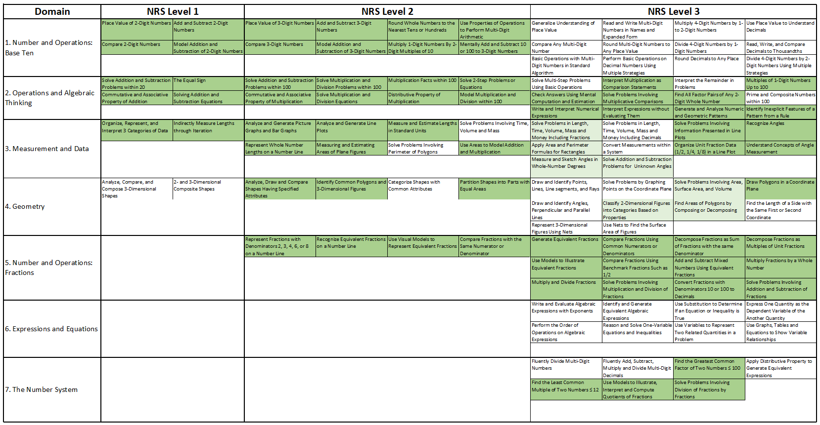
Applications of the Matrix
34
2017-18 The Institute for the Professional Development of Adult Educators
Notes:
Transition slide for presenting the application of the matrix.

Slide 35
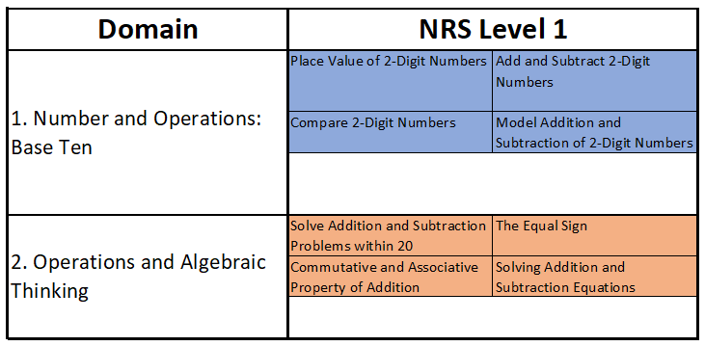
Applications
BY EDUCATORS FOR EDUCATORS
The matrix can be used in planning (daily, weekly, or by unit). Start with the upper leftmost content cell within each region of the matrix then teaching outwards to cover the entire region.
Notes:
As teachers use the matrix in planning, point out that the starting point for every content region in the matrix is the upper leftmost content cell. In this example, after teaching “Place Value of 2-Digit Numbers,” teachers may proceed to either “Adding and Subtracting 2-Digit Numbers” or “Comparing 2-Digit Numbers.” The same process is suggested for other domains and regions such as Operations and Algebraic Thinking Level 1.

Slide 36
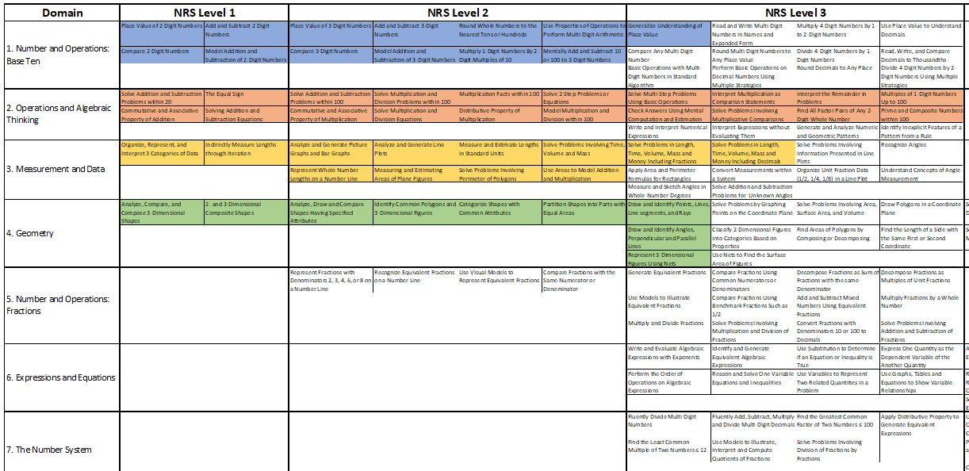
Applications
BY EDUCATORS FOR EDUCATORS
The matrix can be used to track class progress or individual student’s progress, which is important in adjusting the pace of the lesson and design/selection or learning materials/activities.
Notes:
One use of the matrix is to track individual or group progress. Teachers can highlight or cross-out cells which students have demonstrated mastery through formative assessments. Students with similar progress can be grouped together for more effective instruction. Teachers can even use this tool to determine which material, book or online resource to use for small group activities.
In this example, the cells in color are the objectives that students have mastered while the gray ones are the ones that are yet to be mastered.

Slide 37
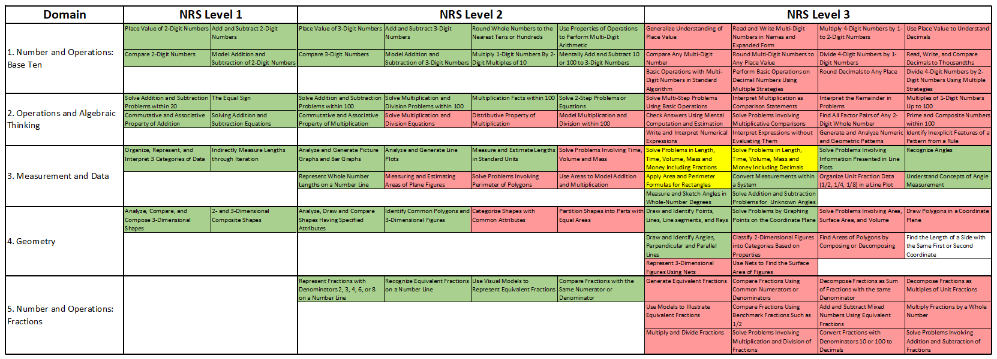
Applications
BY EDUCATORS FOR EDUCATORS
The matrix can be used together with test results to map students strong and weak areas which could lead to developing class, small group or individual student learning profiles.
Differentiating Instruction and Scaffolding
Notes:
This map show’s a student’s learning profile. This is a sample profile of a student that is struggling with area models and fractions. Seeing this map will help the teacher develop lessons, provide remediation, select appropriate materials/activities and implement alternative instructional strategies that would address students’ weaker skills.
Class learning profiles may also be generated for objectives that meet a certain percentage of class mastery. If the image above is a class profile, this shows areas where majority of the students show strength and where majority of the students show weakness. Teachers can then decide which areas in red to remediate or spend more time on.

Slide 38

Applications
BY EDUCATORS FOR EDUCATORS
These group or individual student profiles also help in developing formative assessments to determine mastery of each standard.
Notes:
As individual students or groups of students start demonstrating mastery of skills in red, teachers/students can start marking through the red cells where students have successfully demonstrated mastery.

Slide 39
Applications
BY EDUCATORS FOR EDUCATORS
The matrix can be used to emphasize big ideas or learning trajectories in the standards.
Notes:
Another use of the curriculum matrix in lesson planning is it helps teachers map learning trajectories. Explain that the map above represents a learning trajectory for mastering solving real-world problems involving fractions. Inform the participants that cells in light green cells are partly associated with the trajectory while gray cells are not associated to the learning trajectory at all.

Slide 40
Learning Trajectories
BY EDUCATORS FOR EDUCATORS
A learning trajectory is generally defined as a content-specific learning path, a developmental progression, and/or a building of conceptual components.
G. Mojica (2011). A trajectory toward understanding. University of North Carolina - Chapel Hill, School of Education, NC.
http://thewell.web.unc.edu/2011/10/31/trajectory-toward-understanding/
Notes:
40
Review the definition of learning trajectories from the ABE workshop conducted in 2016. Give a brief information about the research behind this practice. Provide additional explanations, if needed.
Additional information: Dr. Gemma Mojica is an asst. professor of mathematics education at the University of North Carolina - Chapel Hill, School of Education. Her work may be found by visiting http://thewell.web.unc.edu/2011/10/31/trajectory-toward-understanding/

Slide 41
Example
BY EDUCATORS FOR EDUCATORS
Fractions
Ratios
Rate of Change
Equations
Functions
Notes:
41
Provide another example of a learning trajectory.
Explain: It would be most helpful for students to understand why students need to spend so much time learning fractions (and operations). It provides the building blocks for constructing equations and functions. As students learn how functions behave, they are also starting to learn the properties of ratios. As students compare quantities using ratios, students are also learning how to write them in terms of rates of change. Although equations may be thought as something completely separate from rates of change; for some equations like linear equations, in the form y = mx + b, the rate of change or more commonly known as slope (m) is the most important part. For linear equations, the rate of change determines how steep the line rises from left to right. As students study linear equations, they are also studying the first and easiest type of function which is the linear function.

Slide 42
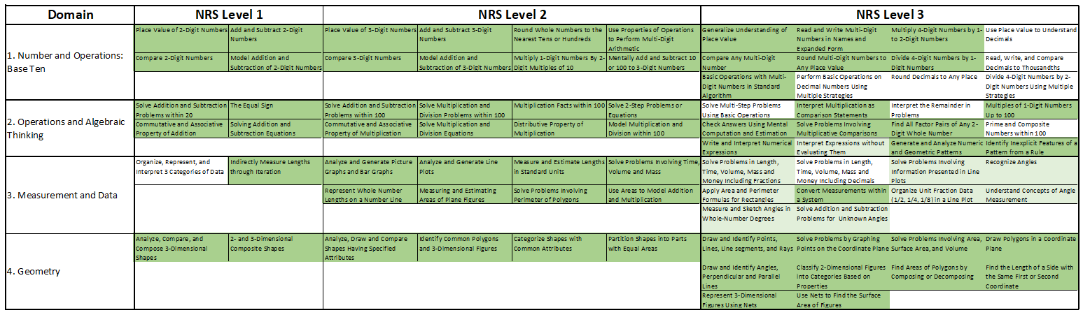
Applications
BY EDUCATORS FOR EDUCATORS
The matrix can be used to emphasize big ideas or learning trajectories towards GED High Impact Indicators and Performance Level Descriptors.
Q.4: Calculate dimensions, perimeter, circumference, and area of two-dimensional figures
Q.5: Calculate dimensions, surface area, and volume of three-dimensional figures
Notes:
All of the indicators listed in the GED® Assessment Target indicators describe the critical thinking skills essential to test-taker success in college, career training, and the workforce. However, the ones GED are highlighting in the High Impact Indicators may be useful for educators to emphasize in their instruction.
GED selected the following skills as High Impact Indicators because:
They represent particular foundational skills that are the basis for the development of other skills covered in the GED® Assessment Targets and have broad usefulness that can be applied in multiple contexts.
They are a good fit for classroom instruction because they are not complicated but are important for students to know and use.
GED® testing data suggests that educators may not be currently focusing on these skills in their GED® test preparation.
While focused classroom instruction on these High Impact Indicators may quickly and positively impact your students' test performance, educators should note that the High Impact Indicators are not more important than the rest of the indicators. Proficiency with all of the indicators is essential for test-takers to perform well on the GED®
test.

Slide 43
Applications
BY EDUCATORS FOR EDUCATORS
High Impact Indicators are skills/objectives that are useful for educators to emphasize in the classroom because they are essential for students in order to perform well on the GED Test.
They represent particular foundational skills that are the basis for the development of other skills covered in the GED® Assessment Targets and have broad usefulness that can be applied in multiple contexts.
They are a good fit for classroom instruction because they are not complicated but are important for students to know and use.
GED® testing data suggests that educators may not be currently focusing on these skills in their GED® test preparation.
Notes:
Briefly review the GED High Impact Indicators.

Slide 44
Benefits to the Teacher/Student
BY EDUCATORS FOR EDUCATORS
Summarizes the ABE math standards in a more visual representation
Shows an overall picture of the ABE math standards
Shows the logical grouping and possible sequencing of the standards
Emphasizes out how each standards relate to one another
Organizes the standards in ABE levels across conceptual categories/domains
Shows how much content/objectives are covered at each ABE level or domain
Notes:
There are several benefits of the matrix to teachers or students. Read/Explain each one to the participants.

Slide 45
Benefits to the Teacher/Student
BY EDUCATORS FOR EDUCATORS
Serves as a quick guide for teachers so that they are able to prioritize and differentiate teaching to the most important skills to adult students based on the student’s ability, curriculum and standardized assessment.
Enumerates every skill/concept/topic that has to be covered in the ABE Math Classroom.
Highlights every standard that is tested in standardized assessments such as the TABE 11 & 12.
Notes:
Continue reading or explain each of the benefits to the participants.

Slide 46

TEST for adult basic Education (TABE) 11 &12
Aligning to Standardized Assessment Targets
46
2017-18 The Institute for the Professional Development of Adult Educators
Notes:
This is the transition slide for discussing the alignment between the matrix and the TABE 11 & 12 Blueprints.

Slide 47
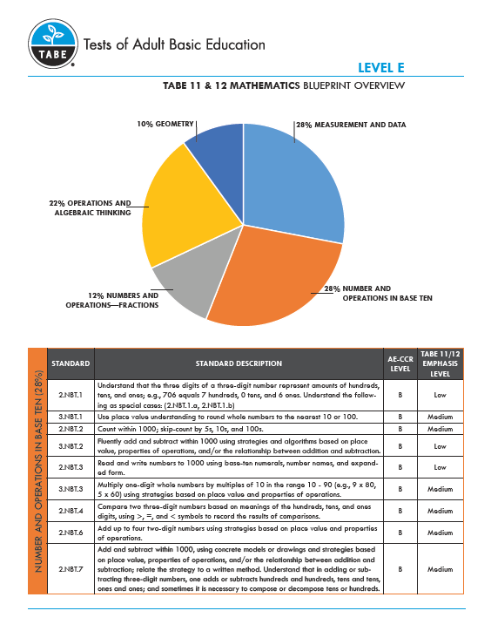
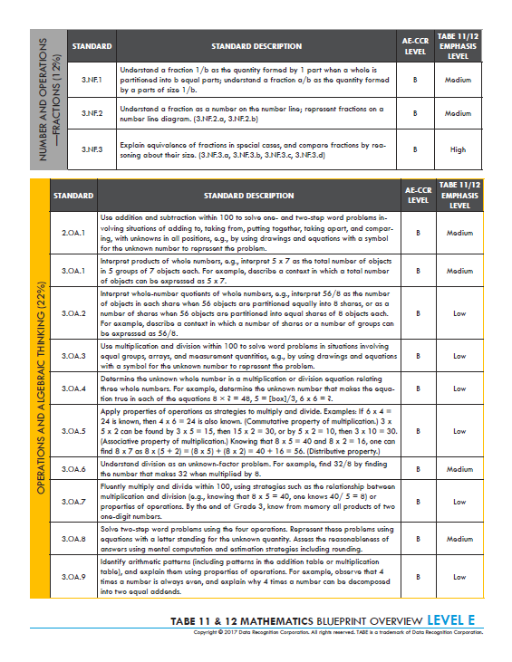
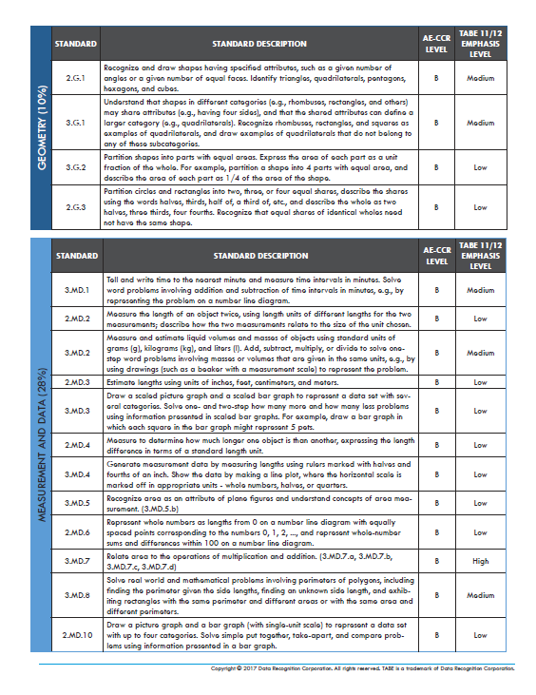
TABE 11 & 12
BY EDUCATORS FOR EDUCATORS
The TABE Level E Assessment Blueprint
Notes:
For purposes of discussion and time, we will only focus on Level E Test.

Slide 48
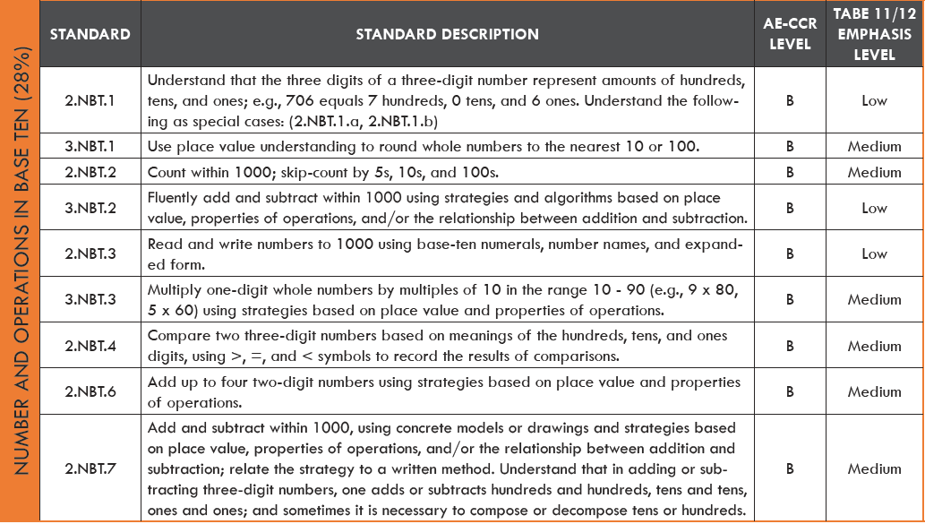
TABE 11 & 12
BY EDUCATORS FOR EDUCATORS
Comparing the Matrix to the TABE Assessment Blueprints
Domain | NRS Level 1 |  | NRS Level 2
1. Number and Operations: Base Ten | Place Value of 2-Digit Numbers | Add and Subtract 2-Digit Numbers | Place Value of 3-Digit Numbers | Add and Subtract 3-Digit Numbers | Round Whole Numbers to the Nearest Tens or Hundreds | Use Properties of Operations to Perform Multi-Digit Arithmetic
 | Compare 2-Digit Numbers | Model Addition and Subtraction of 2-Digit Numbers | Compare 3-Digit Numbers | Model Addition and Subtraction of 3-Digit Numbers | Multiply 1-Digit Numbers By 2-Digit Multiples of 10 | Mentally Add and Subtract 10 or 100 to 3-Digit Numbers
Notes:
Examining both the Mathematics TABE Level E Blueprint and the curriculum matrix shows strong alignment. The wording and separations of each standard may be slightly different between the two but they cover the same content. The matrix content cells highlighted in lighter orange represents standards with low emphasis level on the TABE test while the ones in orange are the ones with medium emphasis level. The next few slides will compare the rest of the domains between the Mathematics TABE Level E Blueprint and the ABE Mathematics Curriculum Matrix.

Slide 49
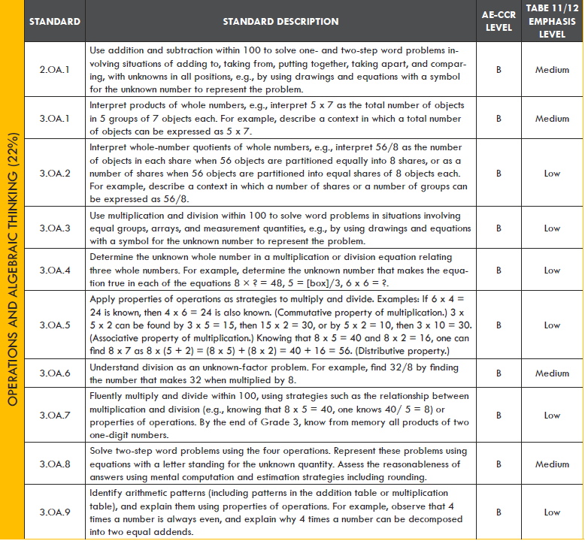
TABE 11 & 12
BY EDUCATORS FOR EDUCATORS
Comparing the Matrix to the TABE Assessment Blueprints
2. Operations and Algebraic Thinking | Solve Addition and Subtraction Problems within 20 | The Equal Sign | Solve Addition and Subtraction Problems within 100 | Solve Multiplication and Division Problems within 100 | Multiplication Facts within 100 | Solve 2-Step Problems or Equations
 | Commutative and Associative Property of Addition | Solving Addition and Subtraction Equations | Commutative and Associative Property of Multiplication | Solve Multiplication and Division Equations | Distributive Property of Multiplication | Model Multiplication and Division within 100
Notes:
The matrix content cells highlighted in lighter yellow represents standards with low emphasis level on the TABE test while the ones in yellow are the ones with medium emphasis level. The cell that is not highlighted in the shade of yellow, “Distributive Property of Multiplication,” means that it is not included in the TABE Level E Blueprint but does not mean it is not important to teach. This may also mean that this content may be assessed at the higher levels of the TABE Test (Level M). This could also mean that the cell is not directly assessed at this level test but is a necessary foundational skill to arrive at the correct answer.

Slide 50
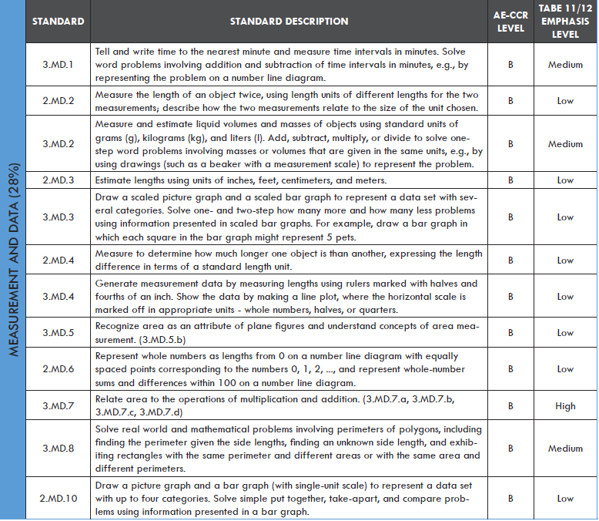
TABE 11 & 12
BY EDUCATORS FOR EDUCATORS
Comparing the Matrix to the TABE Assessment Blueprints
3. Measurement and Data | Organize, Represent, and Interpret 3 Categories of Data | Indirectly Measure Lengths through Iteration | Analyze and Generate Picture Graphs and Bar Graphs | Analyze and Generate Line Plots | Measure and Estimate Lengths in Standard Units | Solve Problems Involving Time, Volume and Mass
 |  |  | Represent Whole Number Lengths on a Number Line | Measuring and Estimating Areas of Plane Figures | Solve Problems Involving Perimeter of Polygons | Use Areas to Model Addition and Multiplication
Notes:
The matrix content cells highlighted in lighter blue represents standards with low emphasis level on the TABE test, the ones in blue are the ones with medium emphasis level and the ones in darker blue are the ones with high emphasis level.

Slide 51
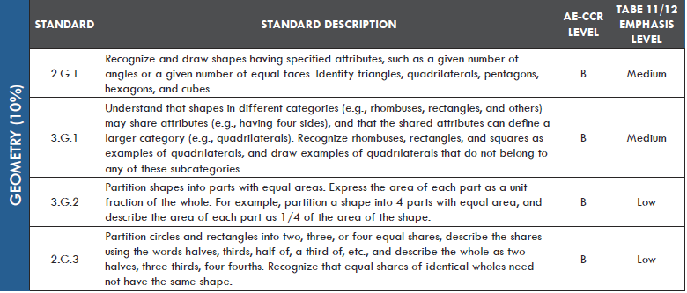
TABE 11 & 12
BY EDUCATORS FOR EDUCATORS
Comparing the Matrix to the TABE Assessment Blueprints
4. Geometry | Analyze, Compare, and Compose 3-Dimensional Shapes | 2- and 3-Dimensional Composite Shapes | Analyze, Draw and Compare Shapes Having Specified Attributes | Identify Common Polygons and 3-Dimensional Figures | Categorize Shapes with Common Attributes | Partition Shapes into Parts with Equal Areas
Notes:
The matrix content cells highlighted in lighter navy blue represents standards with low emphasis level on the TABE test while the ones in navy blue are the ones with medium emphasis level.

Slide 52
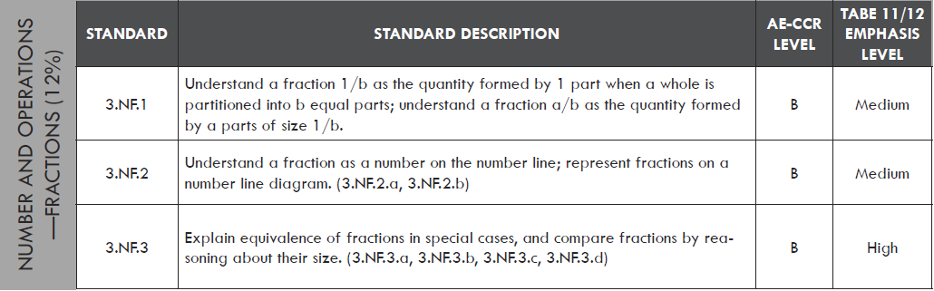
TABE 11 & 12
BY EDUCATORS FOR EDUCATORS
Comparing the Matrix to the TABE Assessment Blueprints
5. Number and Operations: Fractions |  |  | Represent Fractions with Denominators 2, 3, 4, 6, or 8 on a Number Line | Recognize Equivalent Fractions on a Number Line | Use Visual Models to Represent Equivalent Fractions | Compare Fractions with the Same Numerator or Denominator
Notes:
The matrix content cells highlighted in gray represents standards with medium emphasis level on the TABE test, while the ones in darker gray are the ones with high emphasis level. The cell that is not highlighted, “Compare Fractions with the Same Numerator or Denominator,” means that it is not included in the TABE Level E Blueprint but does not mean it is not important to teach. This may also mean that this content may be assessed at the higher levels of the TABE Test (Level M). This could also mean that the cell is not directly assessed at this level test but is a necessary foundational skill to arrive at the correct answer.

Slide 53

THE Various matrix Overlays in Development
53
2017-18 The Institute for the Professional Development of Adult Educators
Notes:
This is the transition slide for presenting the various matrix overlays. Please explain to the participants that these overlays are still in development. Please stay tuned for the anticipated release of these overlays. The printed version of this overlays will come in either transparency film or tracing paper printouts.

Slide 54
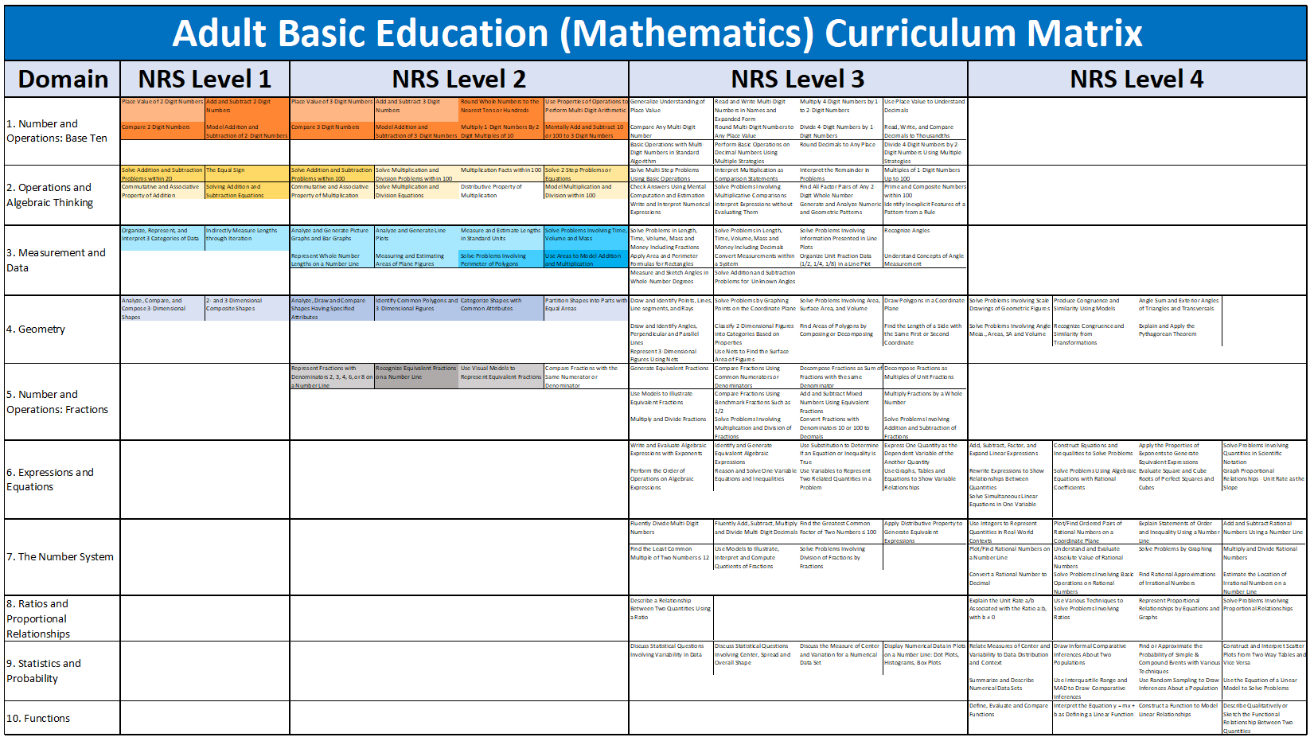
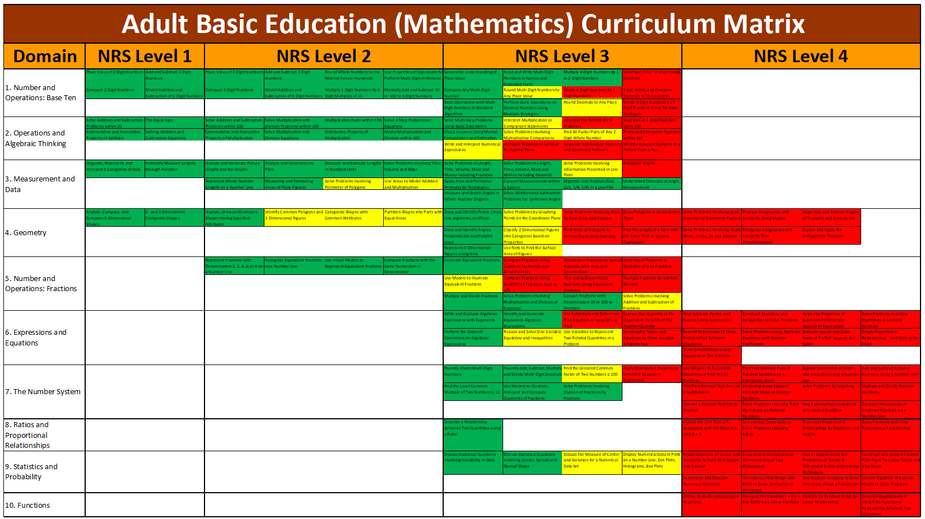
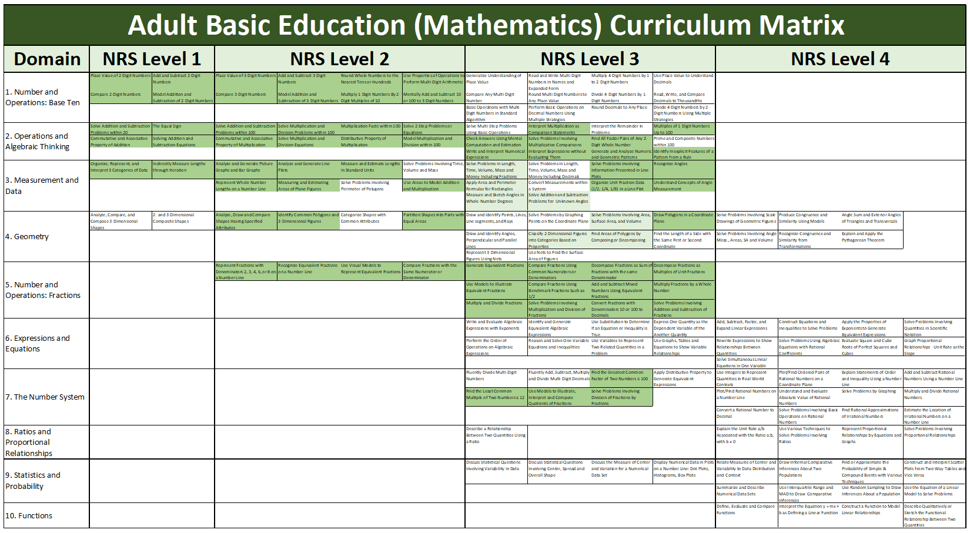
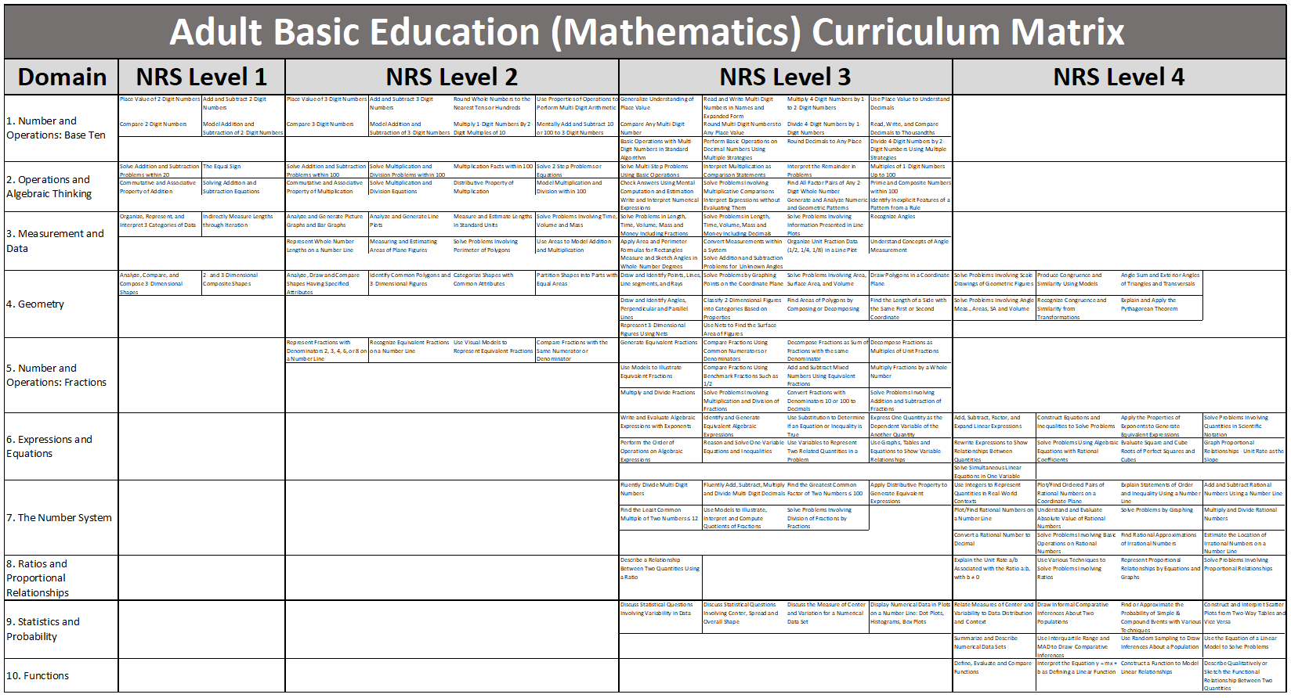
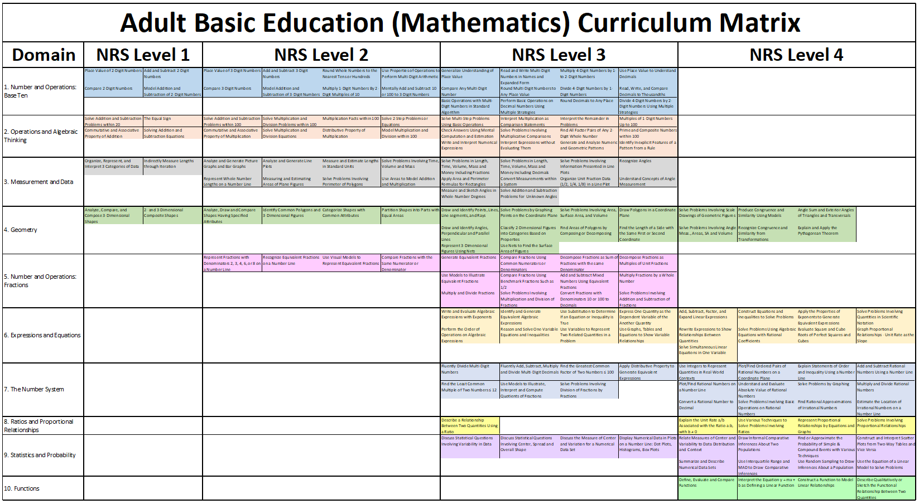
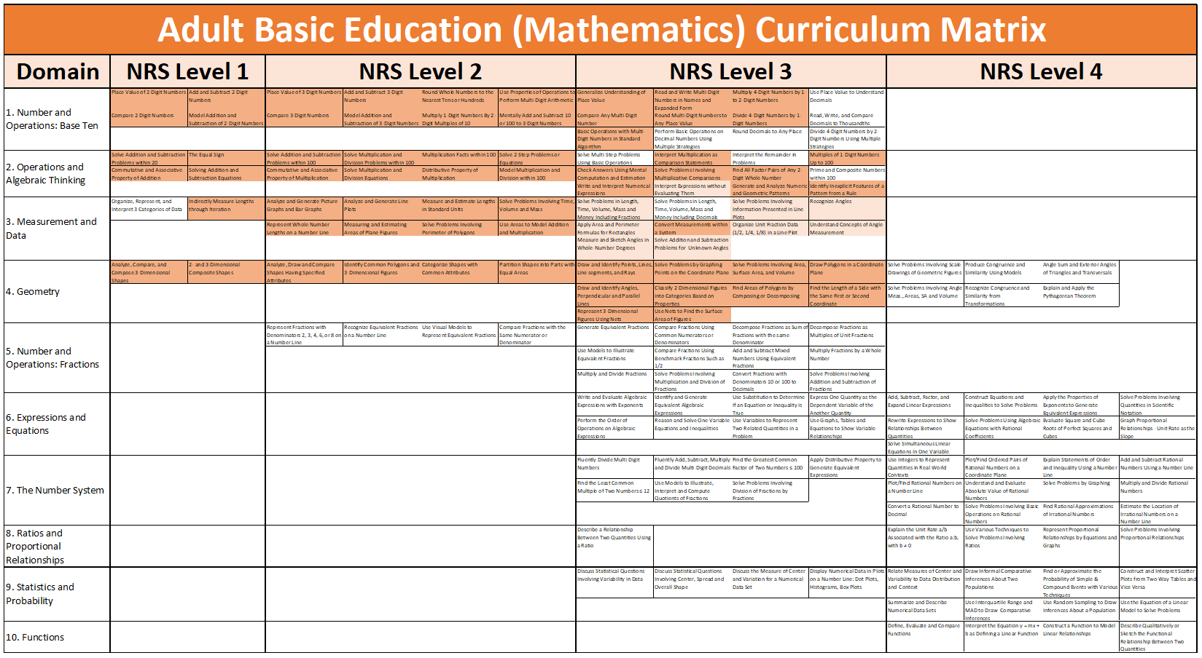
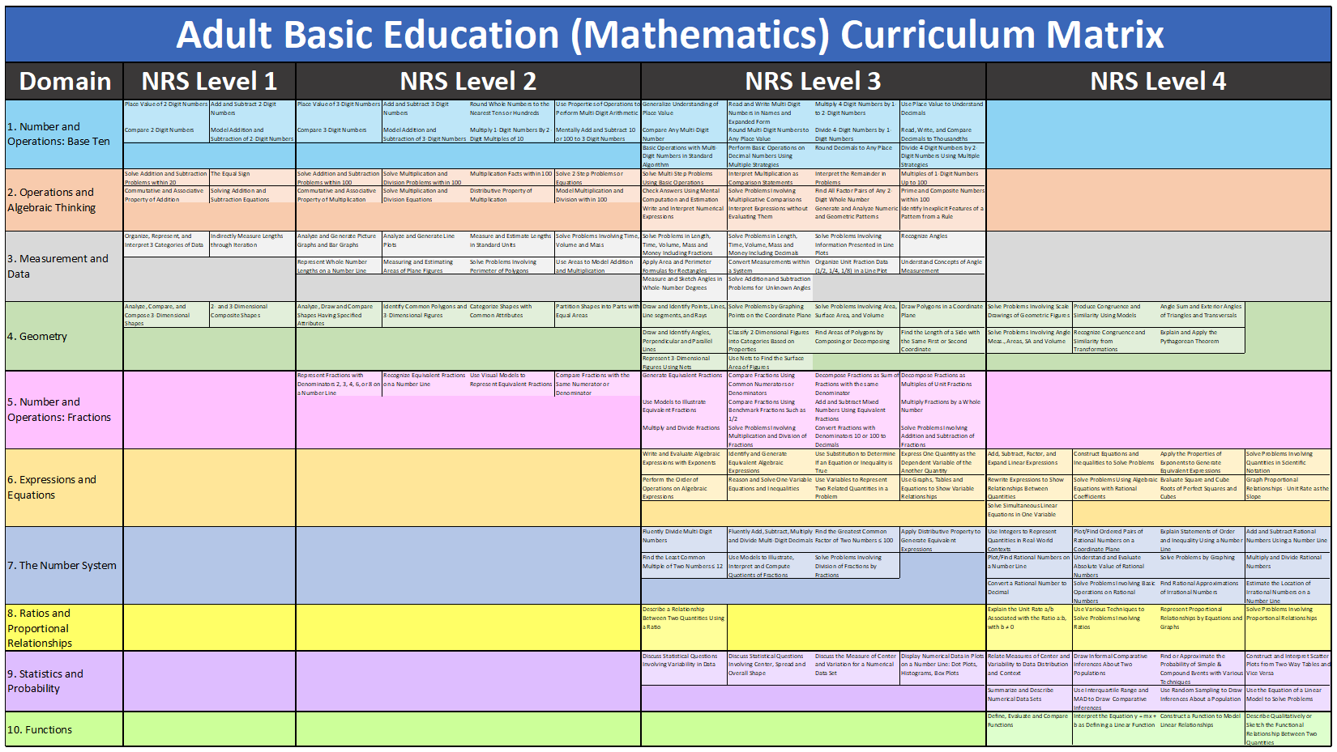
Overlays
Notes:
This is just an animation slide to display the overlays.

Slide 55
Overlays
BY EDUCATORS FOR EDUCATORS
Learning Trajectory Overlays
Notes:
This slide shows a sample learning trajectory overlay towards “Solving Single-Step Linear Equations.” The dark green shade shows content cells that are directly related to “Solving Single-Step Linear Equations” while the light green content cells shows secondary or supplemental content leading to “Solving Single-Step Linear Equations.” These trajectory overlays are most useful in addressing mostly missed questions on standardized tests, project-based learning or targeted instruction.

Slide 56
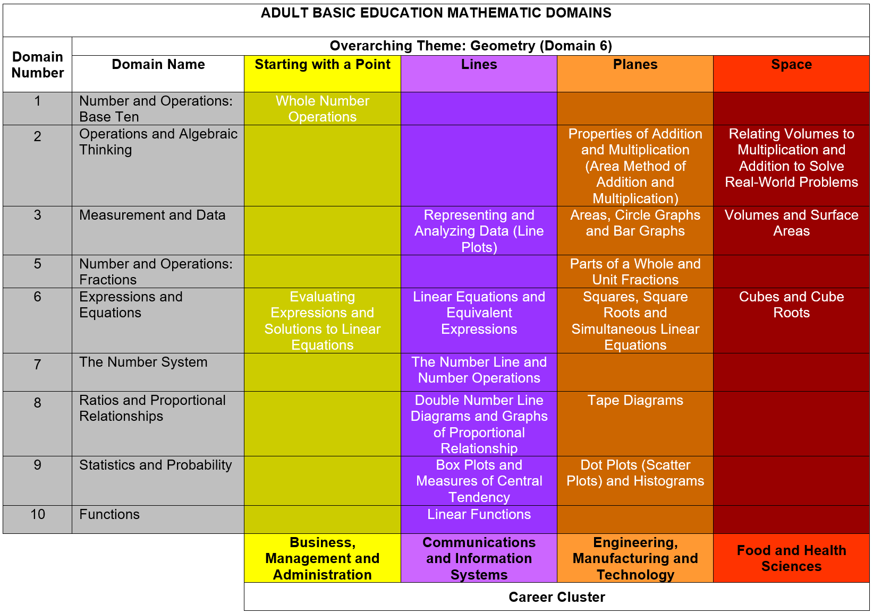
Overlays
BY EDUCATORS FOR EDUCATORS
Thematic and Career Cluster Overlays
Notes:
This slide shows an example of a thematic and career cluster overlays. These overlays will highlight or color content cells that are critical in certain career clusters such as Engineering, Manufacturing and Technology.

Slide 57
Overlays
BY EDUCATORS FOR EDUCATORS
GED High Impact Indicators and Performance Level Descriptors
Notes:
This slide shows an example of a trajectory leading to certain GED High Impact Indicator(s). In this case, this trajectory leads to Q.4: Calculate dimensions, perimeter, circumference, and area of two-dimensional figures and Q.5: Calculate dimensions, surface area, and volume of three-dimensional figures.

Slide 58
Overlays
BY EDUCATORS FOR EDUCATORS
TABE 11 & 12 Blueprint Overlays
Domain | NRS Level 1 |  | NRS Level 2
1. Number and Operations: Base Ten | Place Value of 2-Digit Numbers | Add and Subtract 2-Digit Numbers | Place Value of 3-Digit Numbers | Add and Subtract 3-Digit Numbers | Round Whole Numbers to the Nearest Tens or Hundreds | Use Properties of Operations to Perform Multi-Digit Arithmetic
 | Compare 2-Digit Numbers | Model Addition and Subtraction of 2-Digit Numbers | Compare 3-Digit Numbers | Model Addition and Subtraction of 3-Digit Numbers | Multiply 1-Digit Numbers By 2-Digit Multiples of 10 | Mentally Add and Subtract 10 or 100 to 3-Digit Numbers
2. Operations and Algebraic Thinking | Solve Addition and Subtraction Problems within 20 | The Equal Sign | Solve Addition and Subtraction Problems within 100 | Solve Multiplication and Division Problems within 100 | Multiplication Facts within 100 | Solve 2-Step Problems or Equations
 | Commutative and Associative Property of Addition | Solving Addition and Subtraction Equations | Commutative and Associative Property of Multiplication | Solve Multiplication and Division Equations | Distributive Property of Multiplication | Model Multiplication and Division within 100
3. Measurement and Data | Organize, Represent, and Interpret 3 Categories of Data | Indirectly Measure Lengths through Iteration | Analyze and Generate Picture Graphs and Bar Graphs | Analyze and Generate Line Plots | Measure and Estimate Lengths in Standard Units | Solve Problems Involving Time, Volume and Mass
 |  |  | Represent Whole Number Lengths on a Number Line | Measuring and Estimating Areas of Plane Figures | Solve Problems Involving Perimeter of Polygons | Use Areas to Model Addition and Multiplication
4. Geometry | Analyze, Compare, and Compose 3-Dimensional Shapes | 2- and 3-Dimensional Composite Shapes | Analyze, Draw and Compare Shapes Having Specified Attributes | Identify Common Polygons and 3-Dimensional Figures | Categorize Shapes with Common Attributes | Partition Shapes into Parts with Equal Areas
Notes:
This overlay shows the various content cells within the scope of the TABE Level E Math Blueprint. The lightness and darkness of colors represents the level of emphasis of each content cell whether it is low (light), medium (regular) or high (dark).

Slide 59
Value to programs and Administrators
59
2017-18 The Institute for the Professional Development of Adult Educators
Notes:
Use this slide as a transition slide to talk about how the use of the matrix will benefit administrators, programs or institutions as a whole.

Slide 60

For Programs and Institutions
Standards-Based Instruction Initiatives
Program Evaluation and School Improvement
Teacher Observation and/or Evaluation
Instructional Resource Alignment, Development and/or Evaluation
Curriculum Planning and Pacing
Professional Development
Student Recruitment and Retention
Teacher Empowerment and Retention
Career Pathways Planning and Counseling
Cross-Curricular Collaboration
60
2017-18 The Institute for the Professional Development of Adult Educators

Slide 61


THE interactive online Curriculum Matrix
61
2017-18 The Institute for the Professional Development of Adult Educators
Notes:
Use this slide as a transition slide to talk about the online interactive version of the matrix.

Slide 62

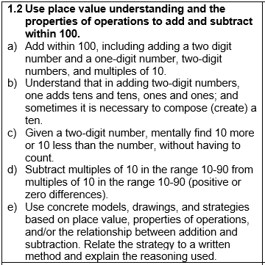

Hyperlinks to Standards and Resources
BY EDUCATORS FOR EDUCATORS
Coming Soon!
Notes:
Soon, the ABE Mathematics Curriculum Matrix will be housed in the IPDAE website where users can simply hover over each cell to display the actual standards and benchmarks contained in each content cell of the matrix. Clicking on the content cells will result to a page listing directly related content from the IPDAE website such as lesson plans, videos, webinars, workshops and toolkits. Teachers can then select the content they will be teaching and use the online resources in developing their lessons. Easy peasy!!!

Slide 63
Additional Curriculum Matrix Resources
63
2017-18 The Institute for the Professional Development of Adult Educators
Notes:
Use this slide as a transition to talk about additional curriculum matrix resources on the IPDAE Website.

Slide 64
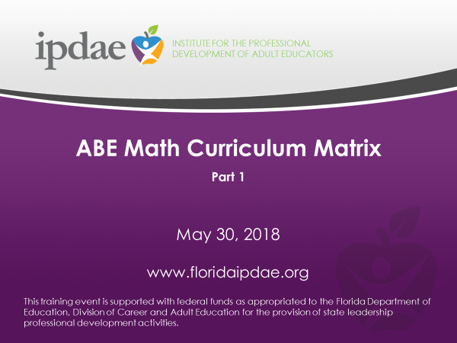
https://www.youtube.com/watch?v=hKs-obd0ufI
floridaipdae.org
64
2017-18 The Institute for the Professional Development of Adult Educators
Notes:
Teachers may view the recorded webinars, ABE Math Curriculum Matrix Parts 1 from the IPDAE website or directly from YouTube. The YouTube Link is posted on the slide.

Slide 65
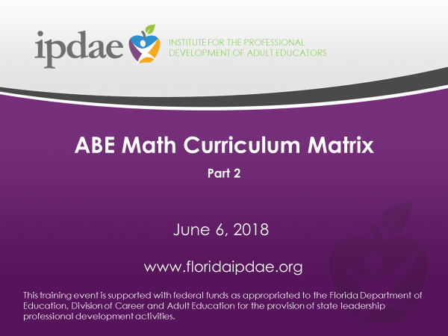
https://www.youtube.com/watch?v=gZ1MEKVppZY
floridaipdae.org
65
2017-18 The Institute for the Professional Development of Adult Educators
Notes:
Teachers may view the recorded webinars, ABE Math Curriculum Matrix Parts 2 from the IPDAE website or directly from YouTube. The YouTube Link is posted on the slide.

Slide 66
floridaipdae.org
66
2017-18 The Institute for the Professional Development of Adult Educators
Notes:
Point out to participants that additional handouts and activity books relating to the matrix can be downloaded from the Presentation Documents Section of each ABE Mathematics Curriculum Matrix Webinars.

Slide 67

Thank You
By Educators For Educators
www.floridaipdae.org
Thank you for your participation!
Notes:
67
Thank all participants for their participation.

Slide 68
